Slide 1

Every Morning, 120 stores wait on one spreadsheet
Fresh · 80
Style · 25
Tech · 15
2 Depots · 60 vehicles, Only 16 can carry chilled
01
Messages
now
Fresh misses 8 AM
Notes:
This is Waypoint every morning. A hundred and twenty stores, sixty vehicles,

Slide 2










Every Morning, 120 stores wait on one spreadsheet
How a delivery runs today
Store Manager
Fresh · 80
Style · 25
Tech · 15
Phones the order in
2 Depots · 60 vehicles, Only 16 can carry chilled
Dispatcher
Types it into a spreadsheet
Messages
now
Loader
Messages
now
Works from a printed list
Fresh misses 8 AM
Driver
Messages
now
Chilled stock spoils
Paper sheet · Invisible once on the road
Disputes rest on memory
01
Notes:
and one dispatcher with a spreadsheet and a phone. It works today, because people work very hard.

Slide 3
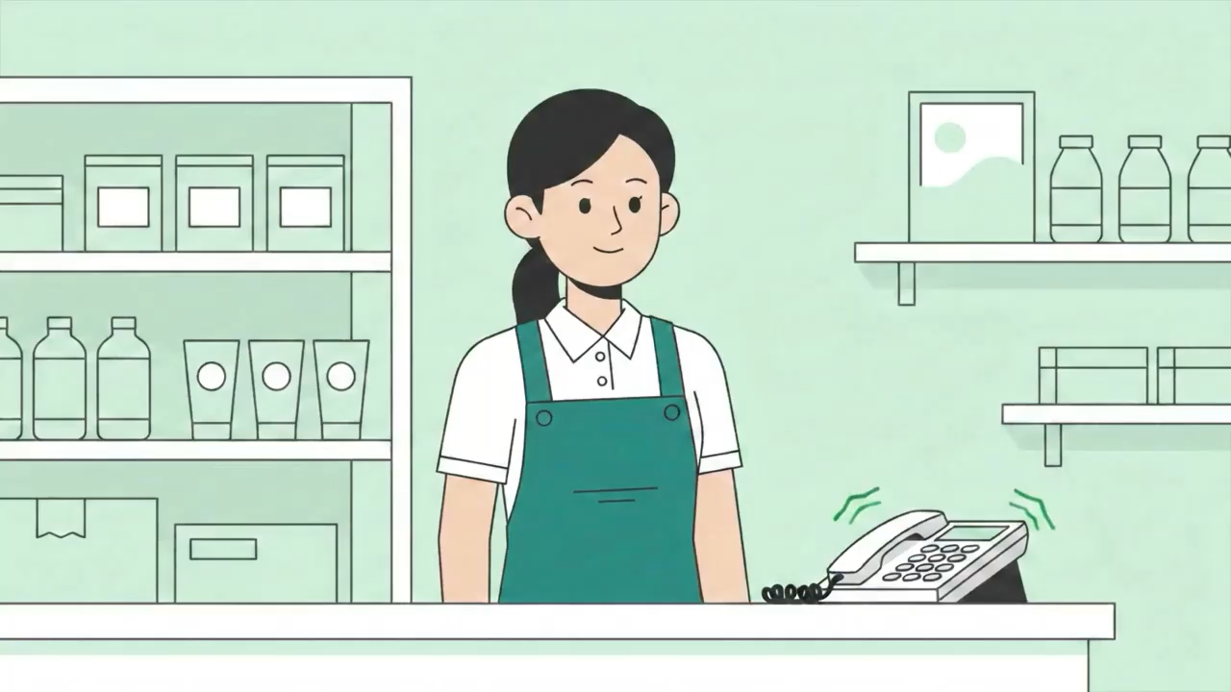
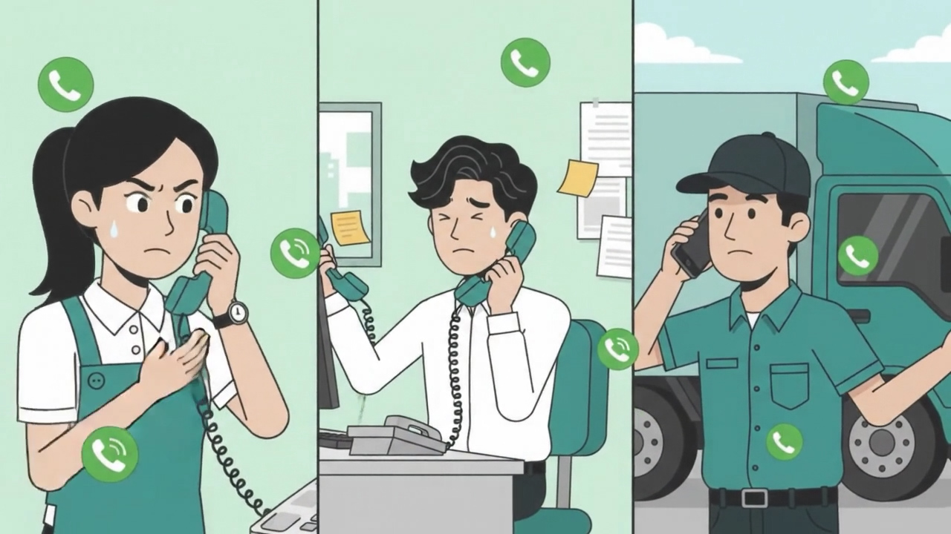
Three problems we found on the
Ground Operations
Vehicle Shortage
02
Poor Coordination
On peak days, there are more orders than vehicles
01
Dispatcher Stress
One late van starts a chain of phone calls
One dispatcher, up to 120 trips a day
03

Slide 4
Three problems we found on the
Ground Operations
02
Vehicle Shortage
Poor Coordination
On peak days, there are more orders than vehicles
One late van starts a chain of phone calls
03
01
Dispatcher Stress
One dispatcher, up to 120 trips a day
Notes:
We found three problems that matter most. On peak days, there are more orders than vehicles, so someone must decide which stores wait.
One dispatcher handles up to a hundred and twenty trips a day: planning, comparing, deferring, watching, alone.
And when one van is late, the phone calls start, one store after another, while every delivery window keeps closing.

Slide 5


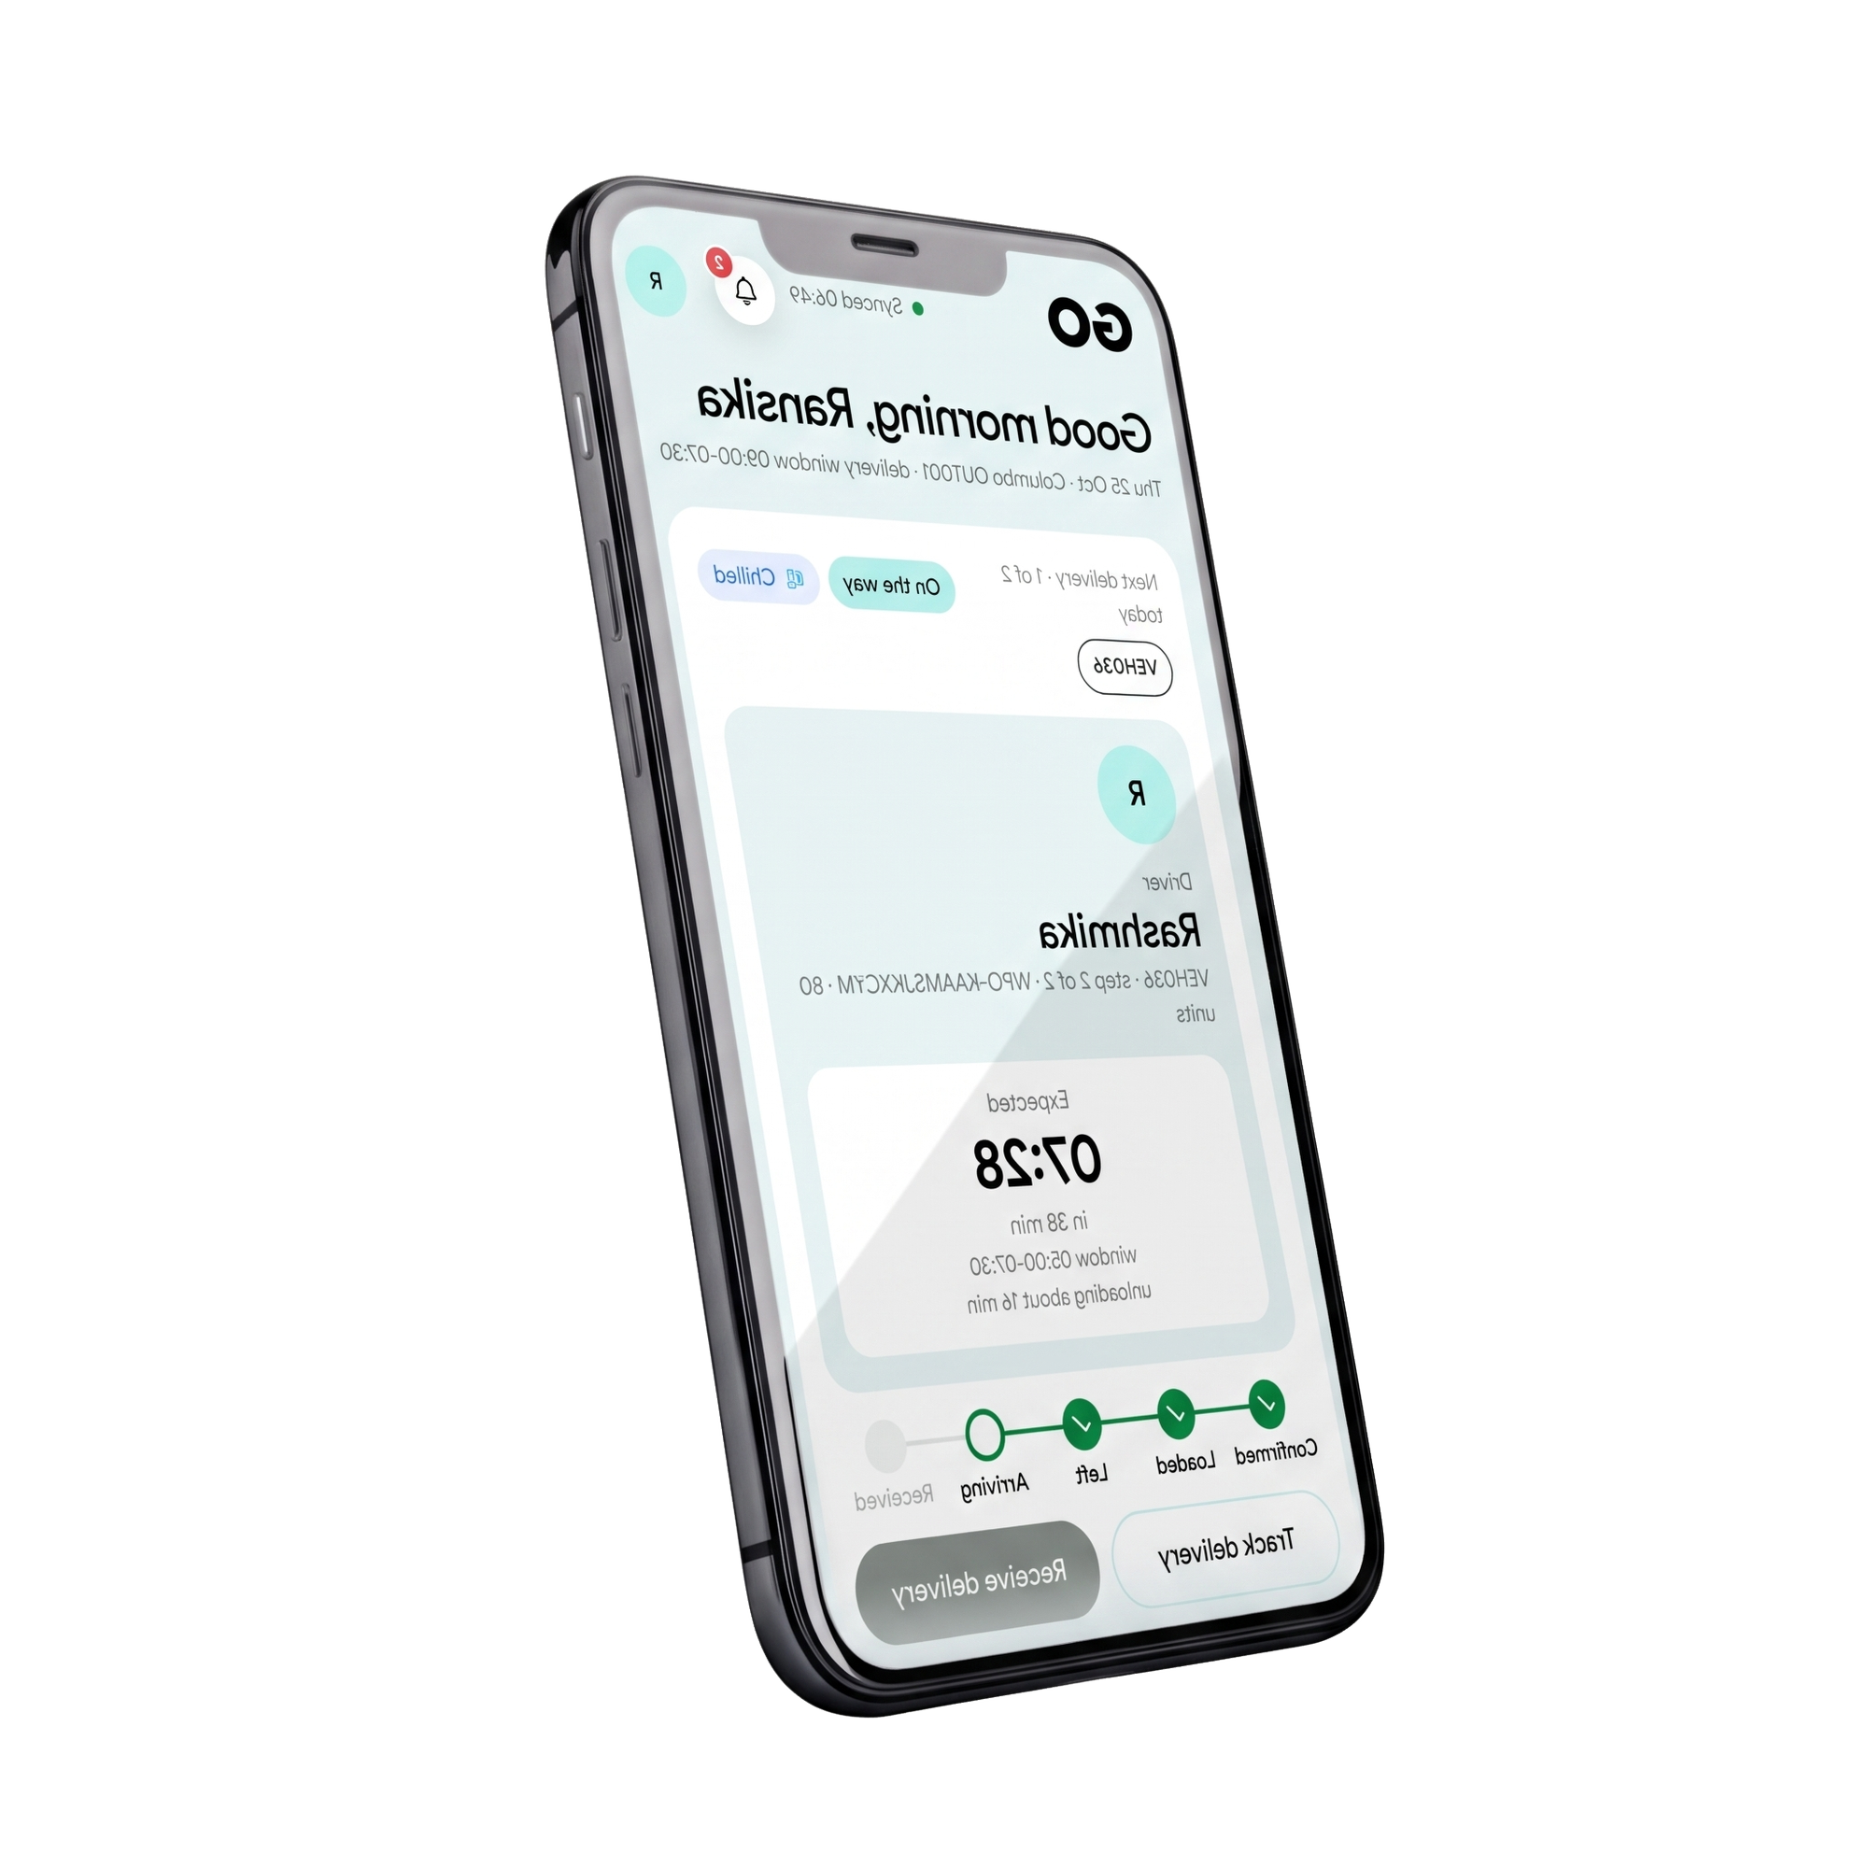
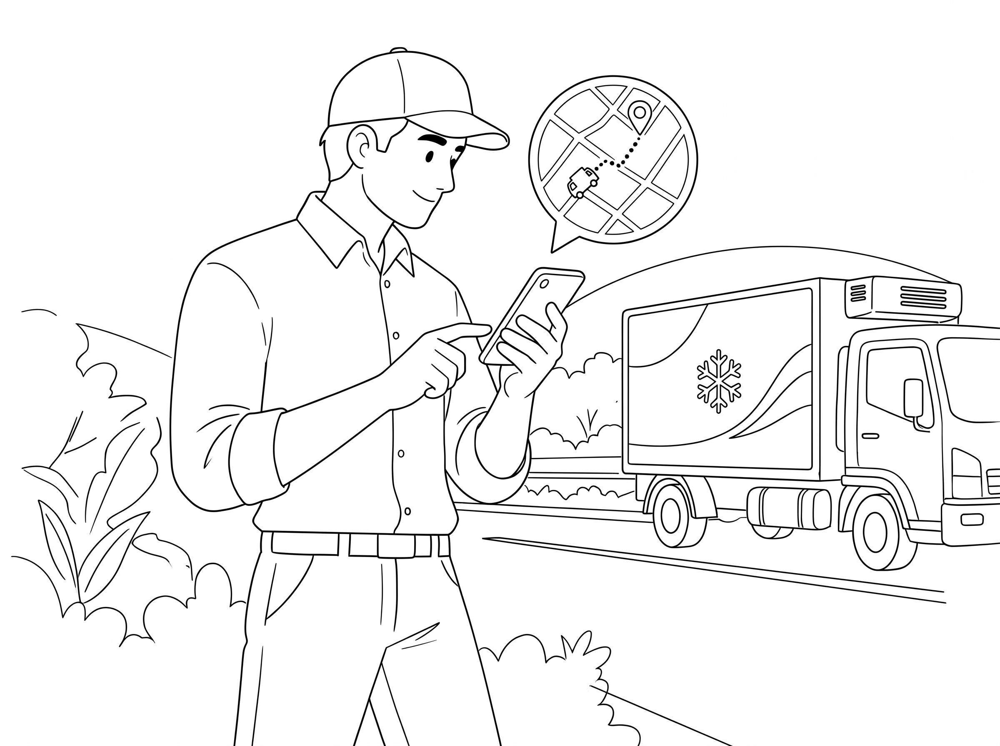



Three problems we found on the
Ground Operations
WayPoint |
WayPoint |
Poor Coordination
4 People One app,
Every Handoff on record
One late van starts a chain of phone calls
02
03
Dispatcher Stress
Vehicle Shortage
One dispatcher, up to 120 trips a day
On peak days, there are more orders than vehicles
01
Notes:
So we built Waypoint GO. Ground Operations.

Slide 6
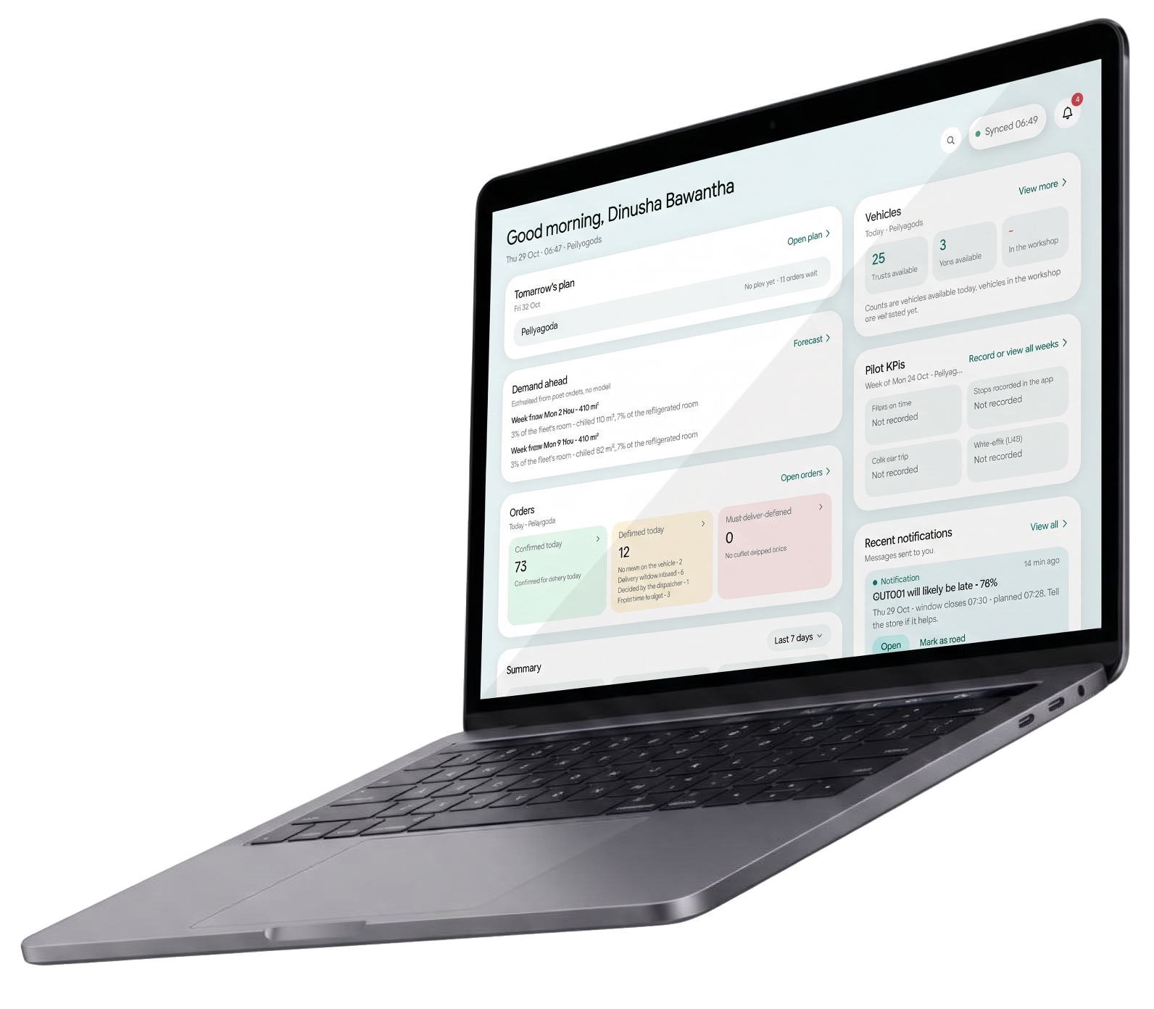
WayPoint |
4 People One app,
Every Handoff on record

Slide 7
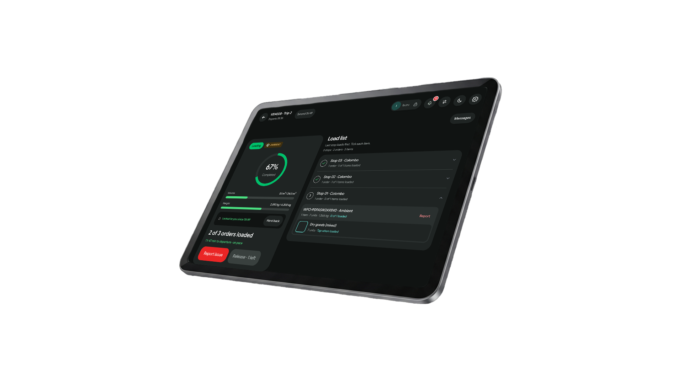
4 People One app,
Every Handoff on record

Slide 8
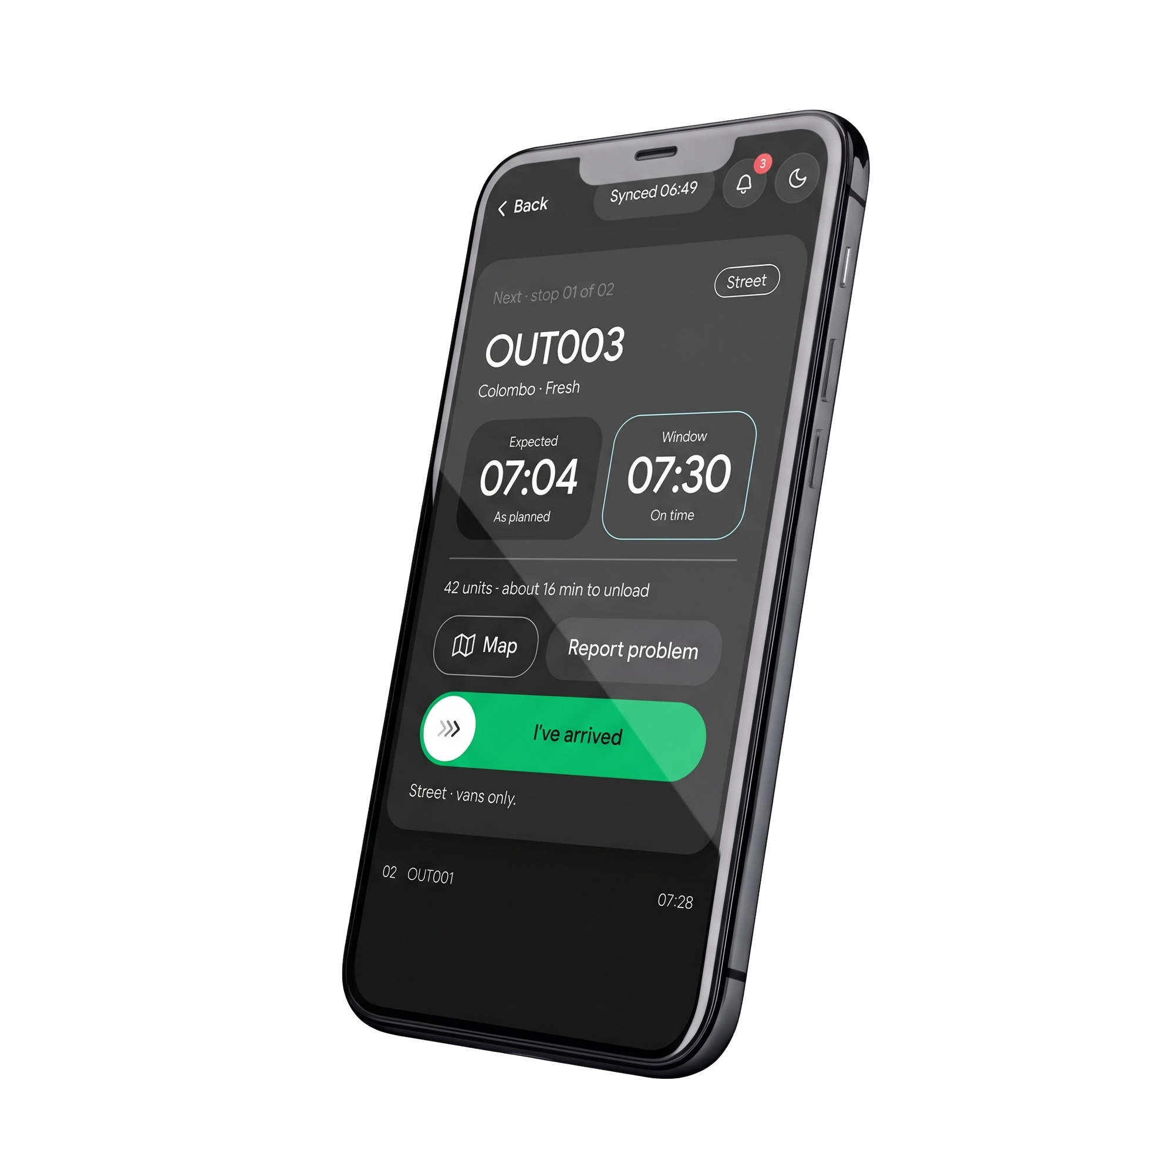
4 People One app,
Every Handoff on record

Slide 9

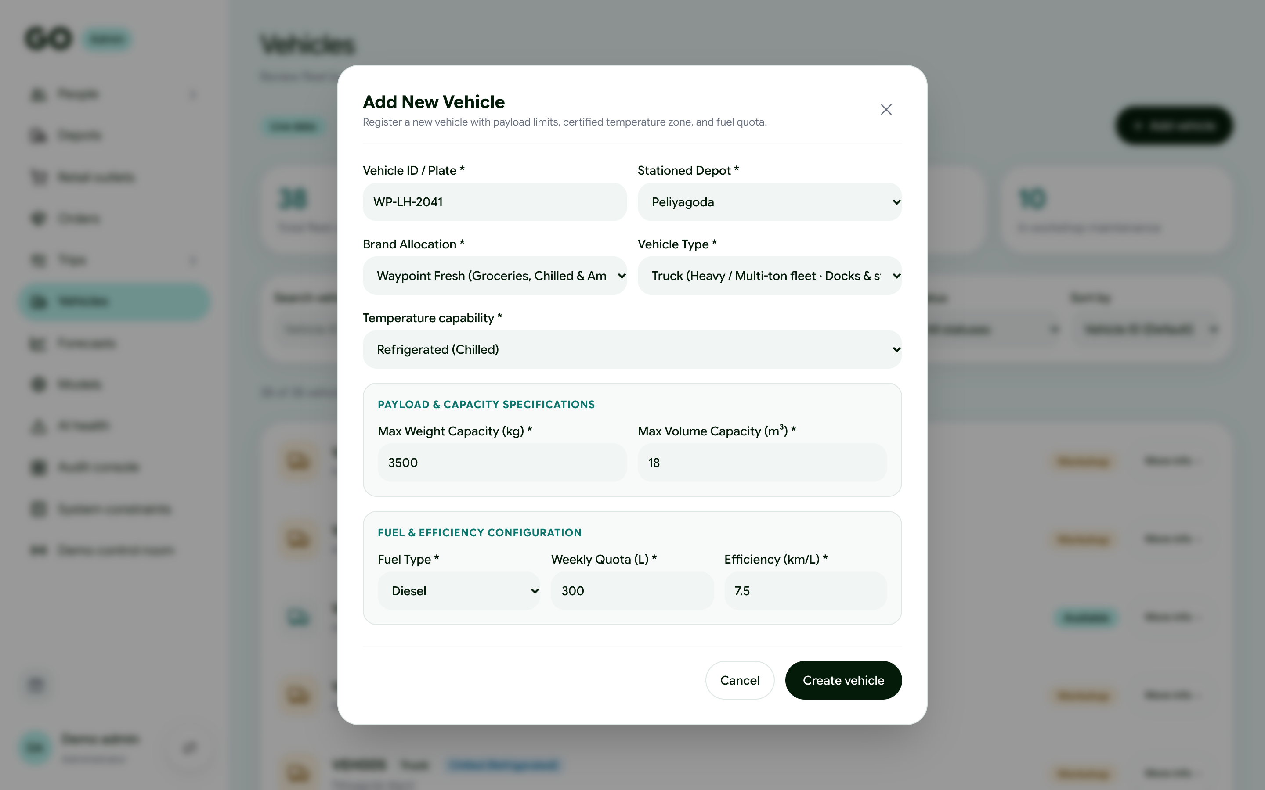
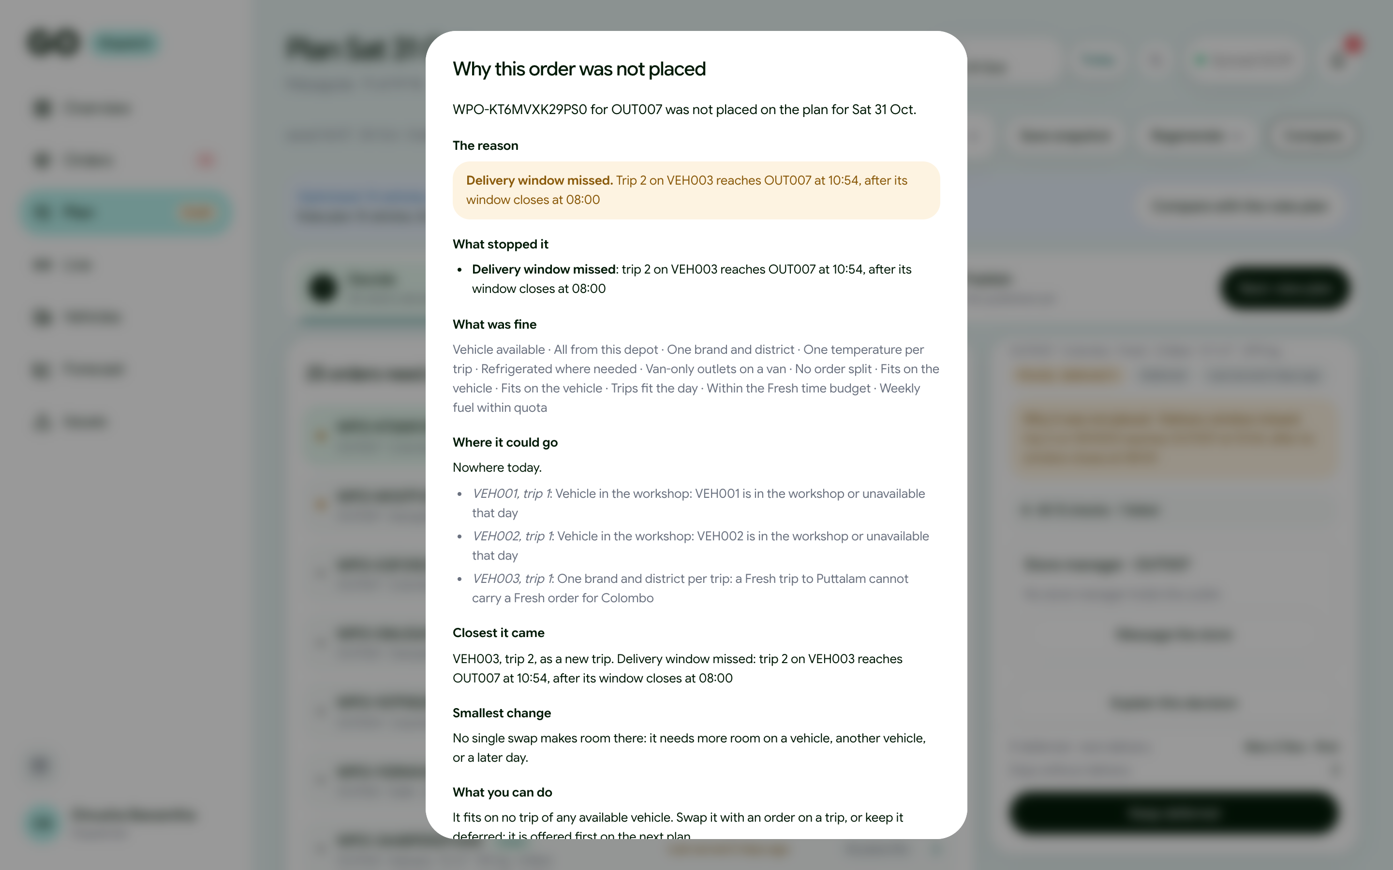
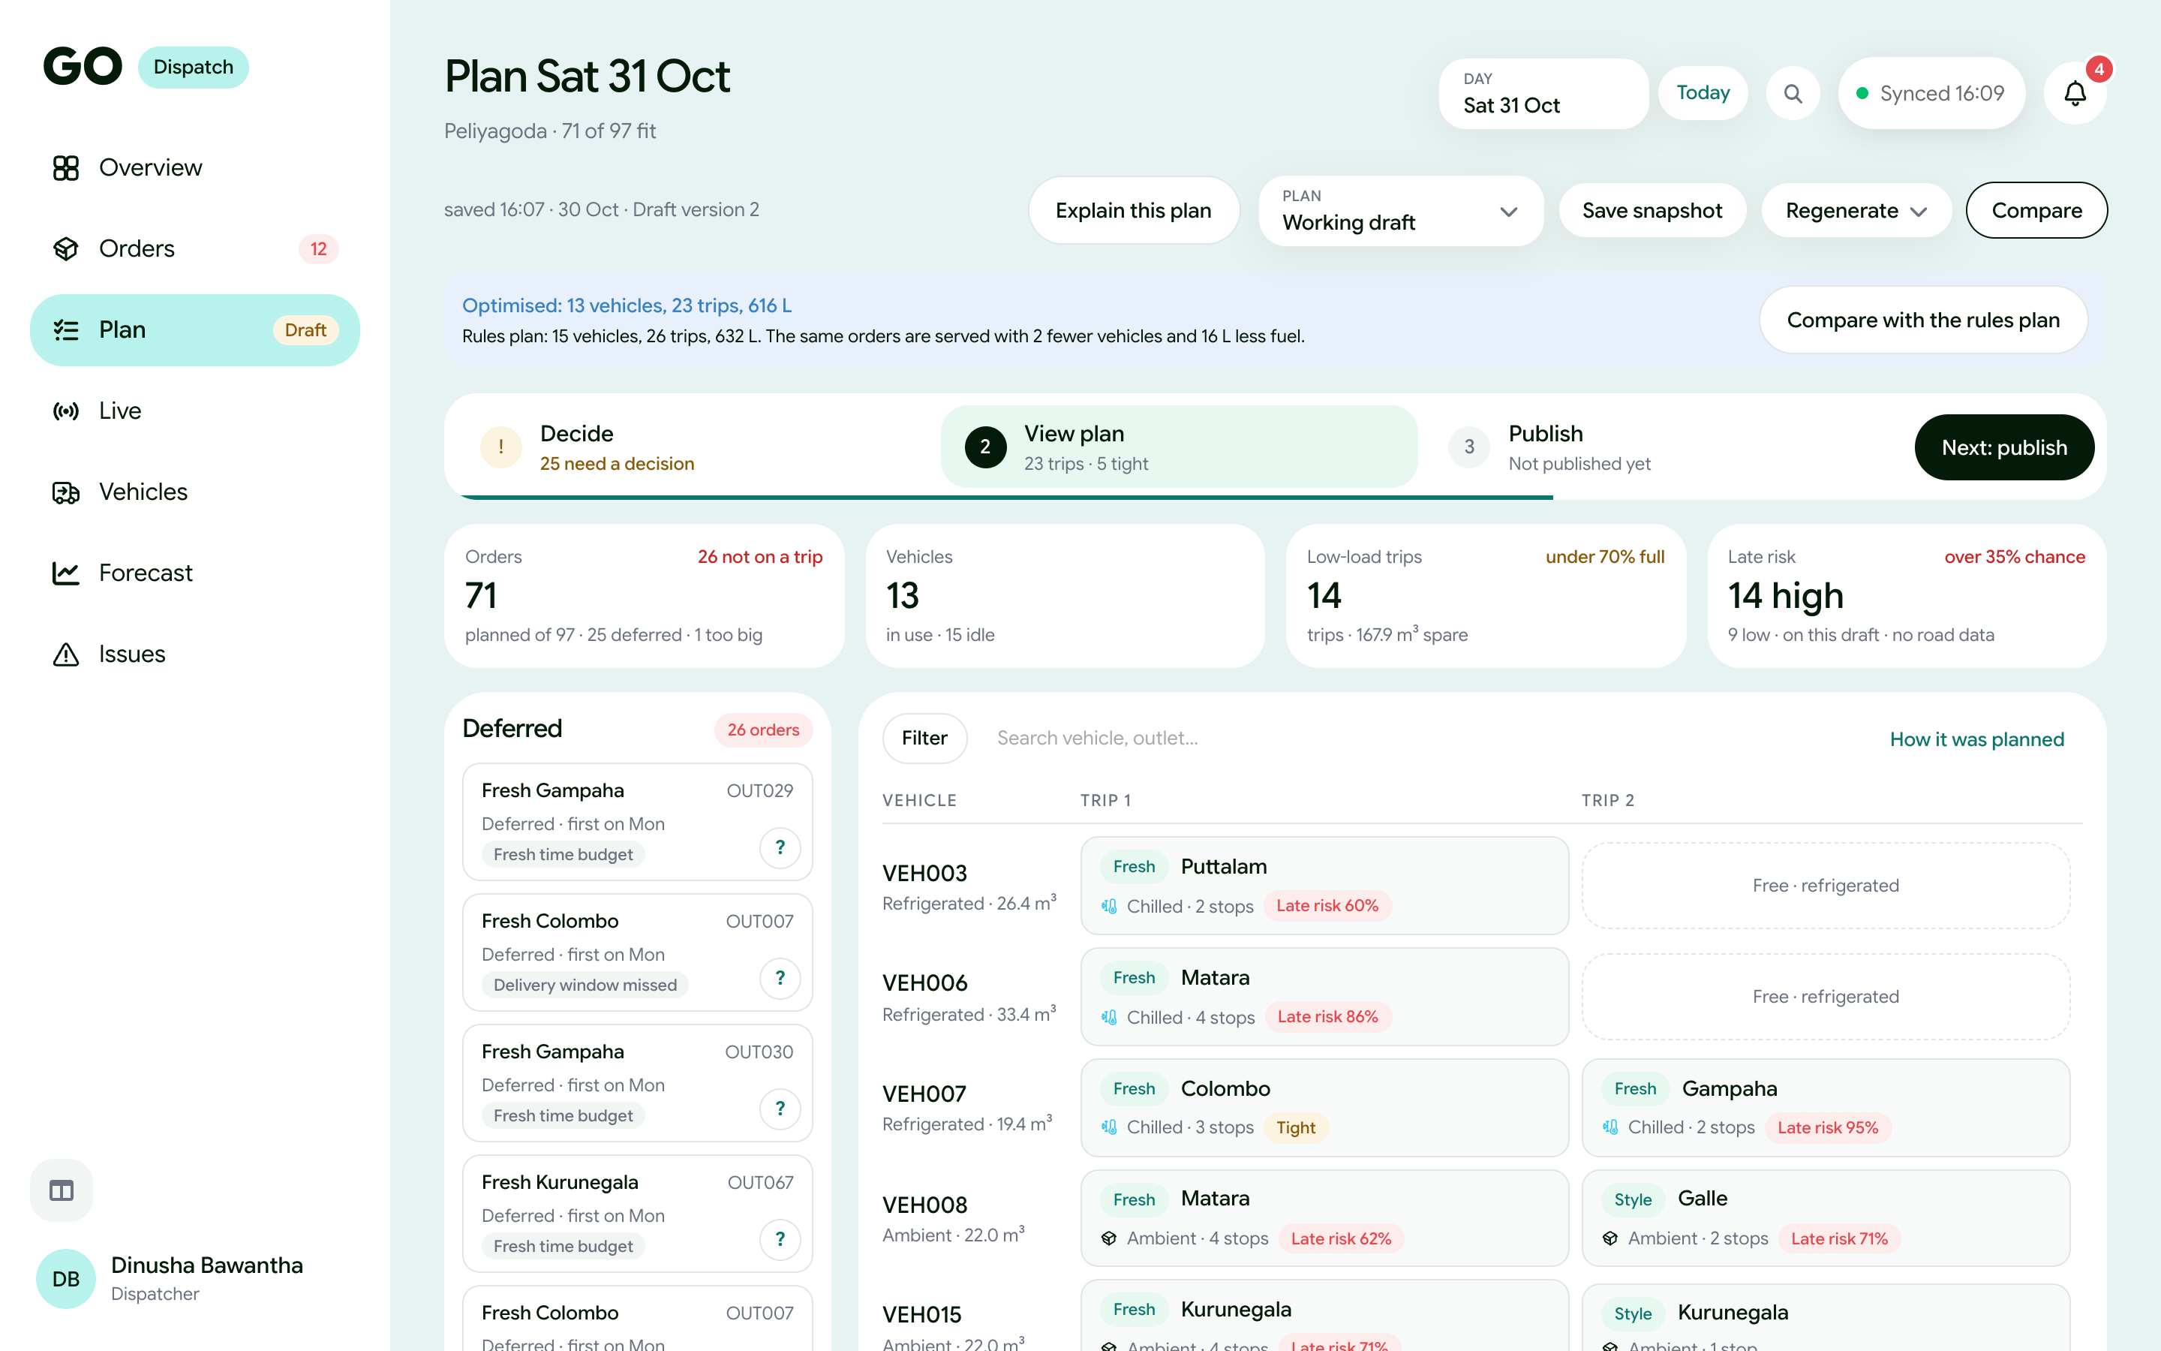
4 People One app,
Every Handoff on record
Problem 1 · Vehicle Shortage
When vehicles run short
Plan in seconds
Plan in seconds
within every vehicle's limits
within every vehicle's limits
Every waiting order explained
the rule, and the smallest change that makes room
Hire ahead
the forecast shows the gap; the admin hires

Slide 10

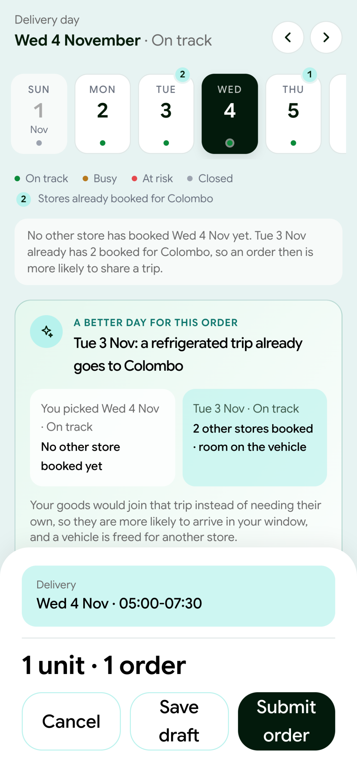
4 People One app,
Every Handoff on record
Problem 1 · Vehicle Shortage
When vehicles run short
Plan in seconds
Plan in seconds
within every vehicle's limits
within every vehicle's limits
Every waiting order explained
Every waiting order explained
the rule, and the smallest change that makes room
the rule, and the smallest change that makes room
Hire ahead
Hire ahead
the forecast shows the gap; the admin hires
the forecast shows the gap; the admin hires
Problem 1 · Vehicle Shortage
GO suggests a day when a vehicle already goes there
Mon
2 Nov
Tue
3 Nov
Tue
3 Nov
Wed
4 Nov
Thu
5 Nov
Thu
5 Nov
Fri
6 Nov
Sat
7 Nov
your pick
3 and 5 Nov: a vehicle already goes to your district
Only a suggestion. The store manager decides.
Notes:
And the forecast shows ten weeks ahead when vehicles will run short, so the admin can hire them in time and add them to the fleet.

Slide 11
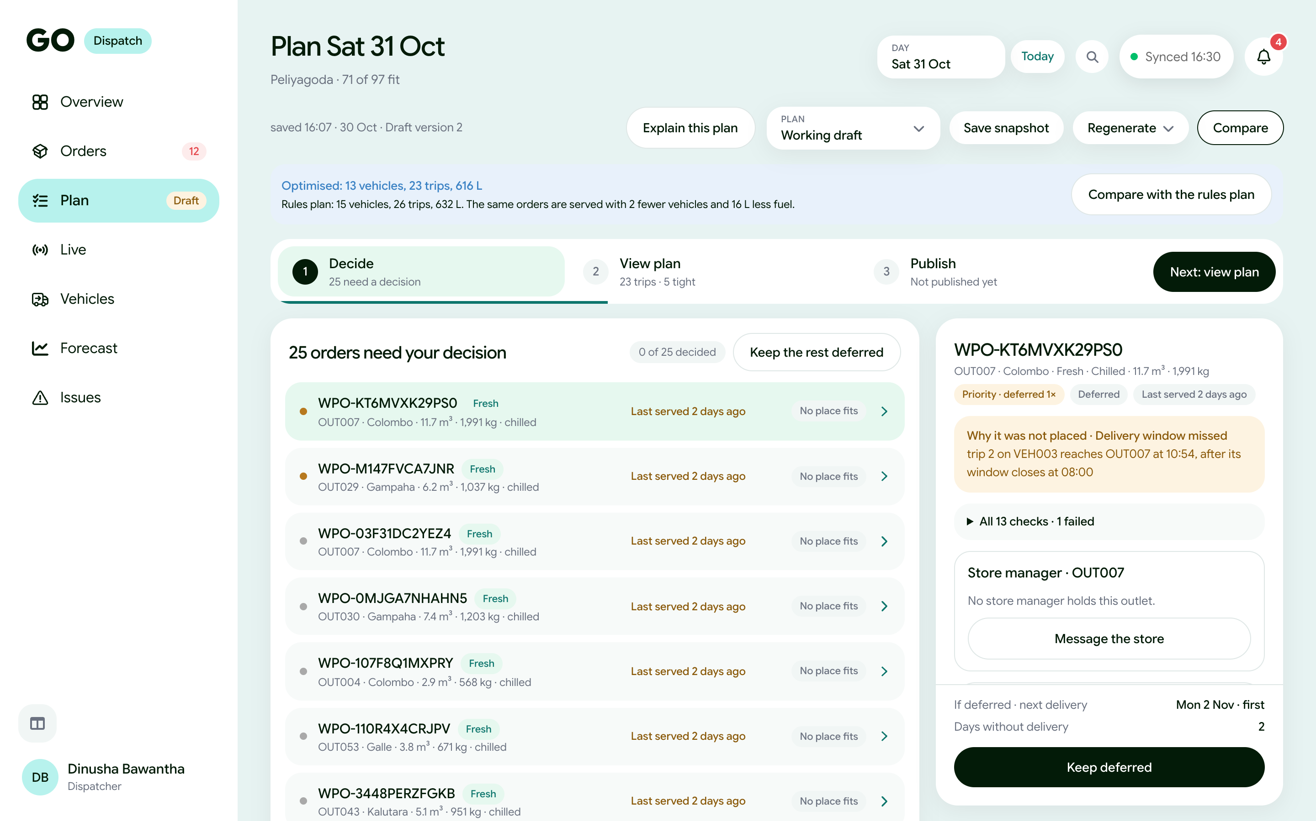
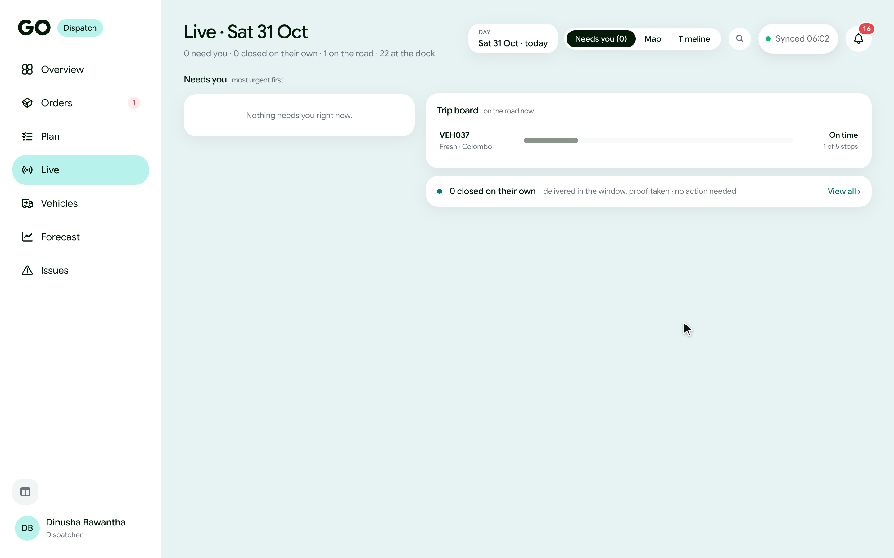
Problem 1 · Vehicle Shortage
When vehicles run short
Plan in seconds
within every vehicle's limits
Every waiting order explained
the rule, and the smallest change that makes room
Hire ahead
Hire ahead
the forecast shows the gap; the admin hires
the forecast shows the gap; the admin hires
Problem 1 · Vehicle Shortage
Problem 2 · Dispatcher Stress
GO watches with them
GO suggests a day when a vehicle already goes there
Watcher
Watcher
alerts only when a decision is needed
alerts only when a decision is needed
Mon
2 Nov
Tue
3 Nov
Tue
3 Nov
Wed
4 Nov
Wed
4 Nov
Thu
5 Nov
Thu
5 Nov
Fri
6 Nov
Sat
7 Nov
Focus page
everything that needs you, in one place
your pick
3 and 5 Nov: a vehicle already goes to your district
Only a suggestion. The store manager decides.
Notes:
And the forecast shows ten weeks ahead when vehicles will run short, so the admin can hire them in time and add them to the fleet.

Slide 12
Problem 1 · Vehicle Shortage
Problem 2 · Dispatcher Stress
GO watches with them
More flexibility across tools
GO suggests a day when a vehicle already goes there
Watcher
Watcher
alerts only when a decision is needed
alerts only when a decision is needed
Mon
2 Nov
Tue
3 Nov
Tue
3 Nov
Wed
4 Nov
Wed
4 Nov
Thu
5 Nov
Thu
5 Nov
Fri
6 Nov
Sat
7 Nov
Focus page
Focus page
everything that needs you, in one place
everything that needs you, in one place
your pick
3 and 5 Nov: a vehicle already goes to your district
Only a suggestion. The store manager decides.
Compare plans
Compare plans
Drag & Drop
Defer
GO brings the tools. The dispatcher brings the know-how.
Notes:
And the forecast shows ten weeks ahead when vehicles will run short, so the admin can hire them in time and add them to the fleet.

Slide 13
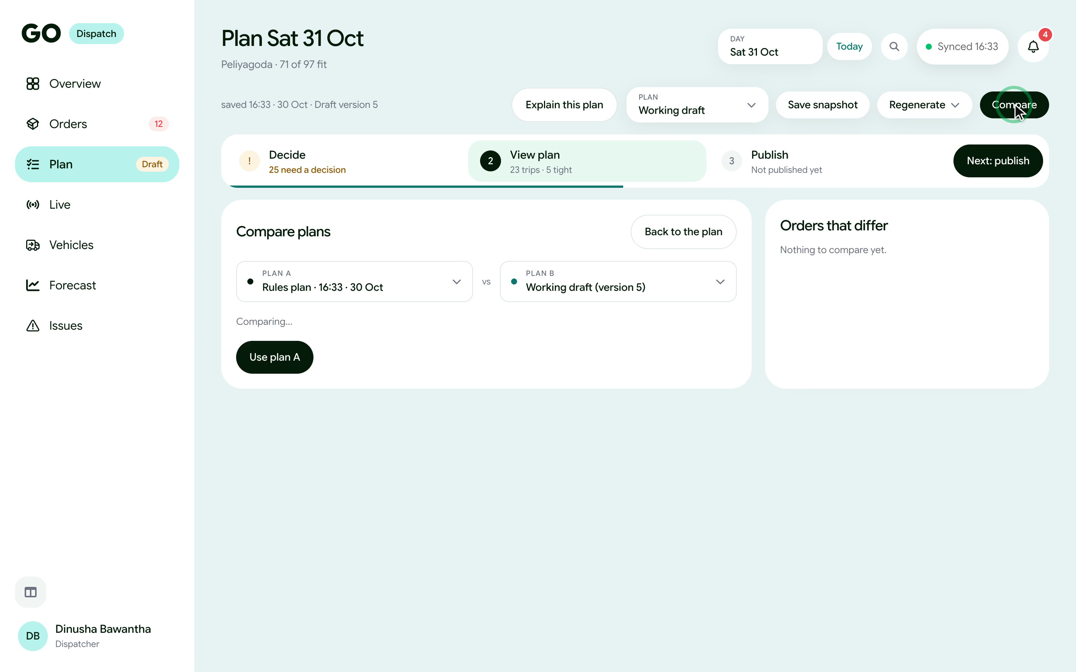
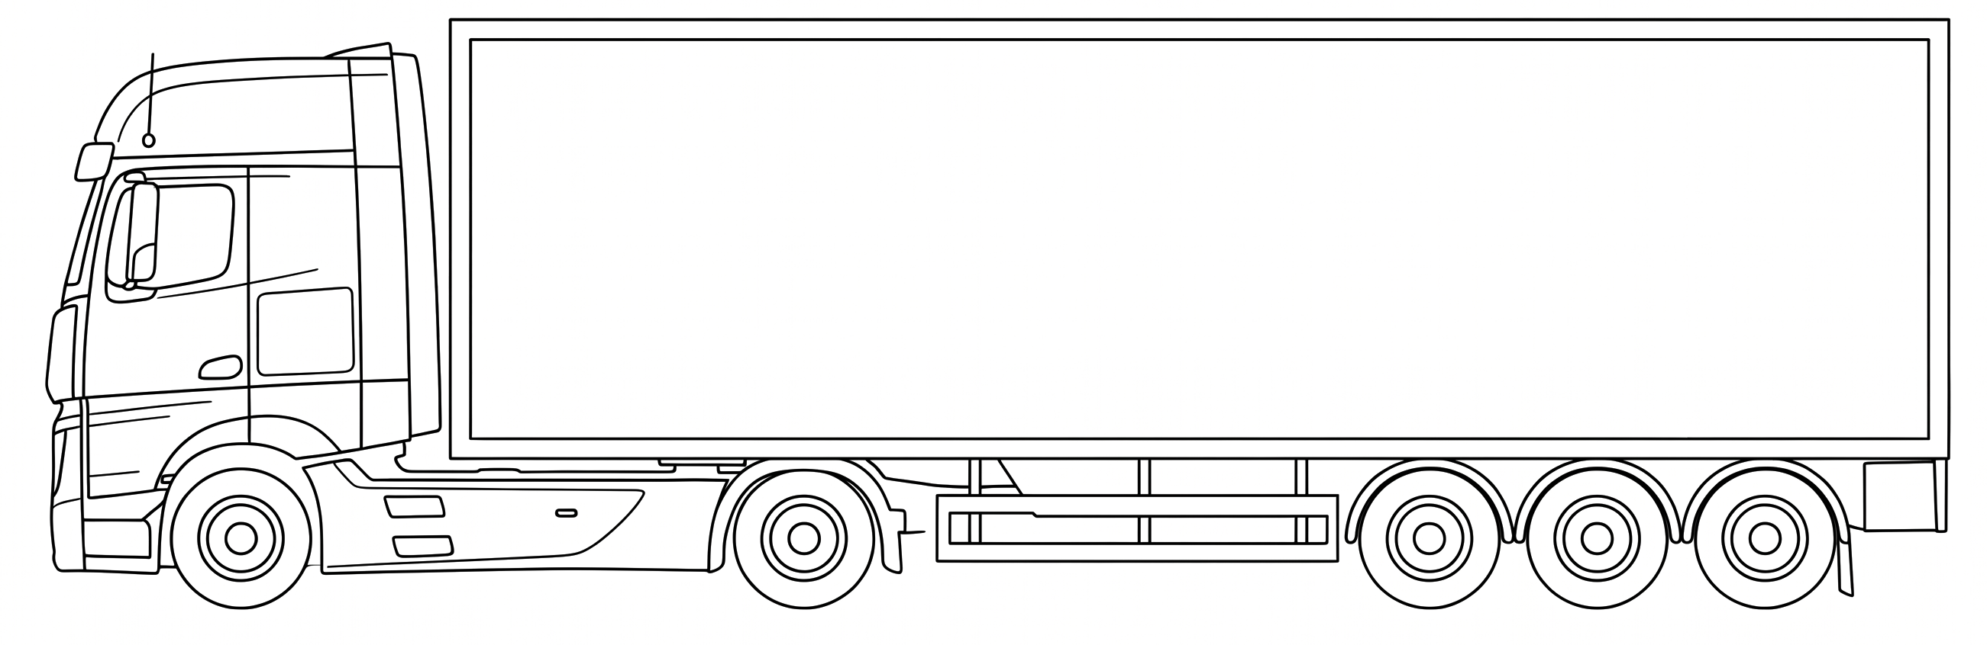
Watcher
alerts only when a decision is needed
Focus page
Focus page
everything that needs you, in one place
everything that needs you, in one place
Problem 3 · Poor Coordination
Problem 2 · Dispatcher Stress
GO watches with them
More flexibility across tools
Now, a trip on the road
Compare plans
Compare plans
Drag & Drop
Drag & Drop
Defer
Defer
Store 1
Store 2
Store 3
Store 4
Store 5
GO brings the tools. The dispatcher brings the know how.
Notes:
And the forecast shows ten weeks ahead when vehicles will run short, so the admin can hire them in time and add them to the fleet.

Slide 14



Problem 3 · Poor Coordination
Problem 3 · Poor Coordination
Problem 2 · Dispatcher Stress
More flexibility across tools
Ground operations break in ways no plan expects
Now, a trip on the road
Compare plans
On time, but the store closed early today
The store is open, the mall's loading bay is not
A van breaks down with chilled goods inside
Store 1
Store 2
Store 3
Store 4
Store 5
Drag & Drop
Defer
Defer
Skip store 3?
Nobody at the store to receive
Loader: “all loaded.” Store: “three cartons missing.”
Delivered with no signal, while the dispatcher skipped that store
Store 1
Store 2
Store 3
Store 4
Store 5
GO brings the tools. The dispatcher brings the know-how.
Its goods are in front of store 4's.
Notes:
And the forecast shows ten weeks ahead when vehicles will run short, so the admin can hire them in time and add them to the fleet.

Slide 15

Problem 3 · Poor Coordination
Problem 3 · Poor Coordination
Ground operations break in ways no plan expects
Now, a trip on the road
On time, but the store closed early today
The store is open, the mall's loading bay is not
A van breaks down with chilled goods inside
Store 1
Store 2
Store 3
Store 4
Store 5
Skip store 3?
Nobody at the store to receive
Loader: “all loaded.” Store: “three cartons missing.”
Delivered with no signal, while the dispatcher skipped that store
Its goods are in front of store 4's.
Store 3
Store 4
Store 5
Problem 3 · Poor Coordination
Today, a chain of phone calls
Driver
Dispatcher
Store 01
Store 02
Store 03
One call at a time.
Nobody sees the whole picture.
Nothing on record.
Notes:
And the forecast shows ten weeks ahead when vehicles will run short, so the admin can hire them in time and add them to the fleet.

Slide 16
Problem 3 · Poor Coordination
Ground operations break in ways no plan expects
On time, but the store closed early today
The store is open, the mall's loading bay is not
A van breaks down with chilled goods inside
Nobody at the store to receive
Loader: “all loaded.” Store: “three cartons missing.”
Delivered with no signal, while the dispatcher skipped that store
Problem 3 · Poor Coordination
Today, a chain of phone calls
07:12 → 07:31, one call at a time
Driver
Dispatcher
Store 01
Store 02
Store 03
One call at a time.
Nobody sees the whole picture.
Nothing on record.
Notes:
Today, that decision is made by phone. The dispatcher calls the driver, then store three, then store four, then the driver again. One call at a time. Nobody sees the whole picture, the window keeps closing, and by evening nothing is on record.

Slide 17
Problem 3 · Poor Coordination
Three obvious answers, and why each breaks
3
1
Let AI decide everything
Buy a routing or tracking tool
A WhatsApp group
Who answers when it gets it wrong?
It moves the van. It doesn't get store 4 to agree.
Fast, but no structure. No record.
2
Notes:
Let AI decide everything? When it leaves the same store waiting two days running, who answers for it? And it doesn't know which manager opens late, or which road floods. (click) Buy a routing or tracking tool? It can move the van, but it can't get store four to lend its dock. (click) Start a WhatsApp group? Fast, but nothing in it is structured, and nothing is on record. (pause) Each one fixes one thing and breaks another.

Slide 18
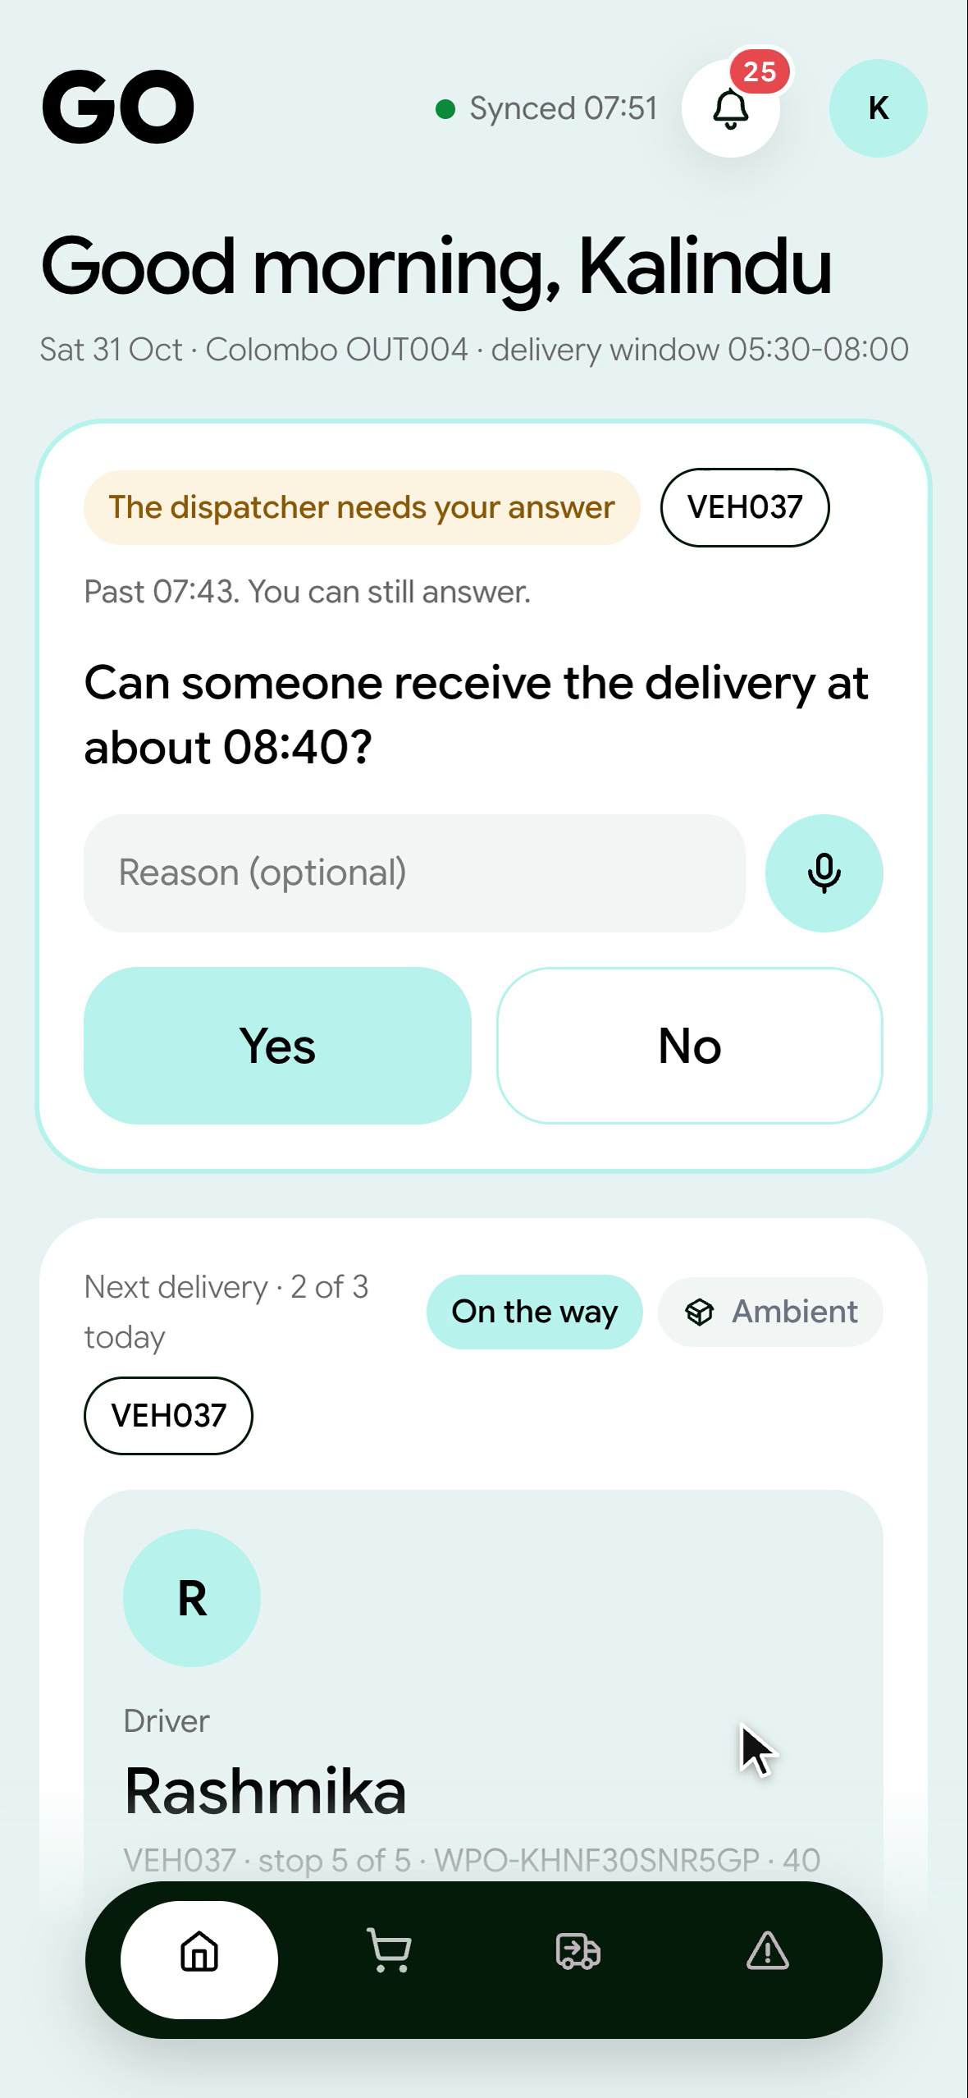
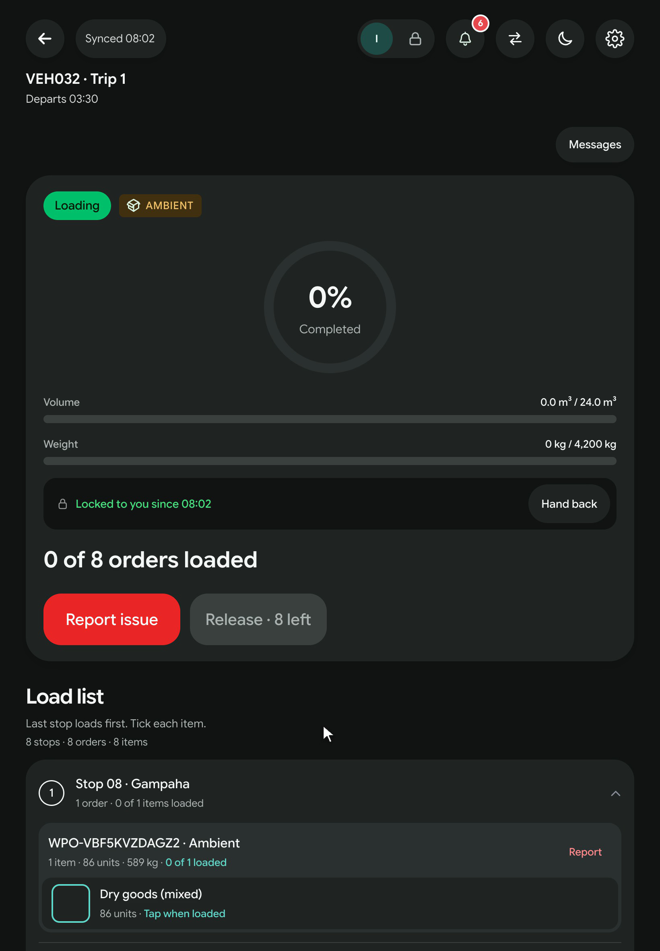

Problem 3 · Poor Coordination
Two kinds of problems
A
Can be settled later
B
Can't wait
Missing goods · Damage · Shortages
Window closing · Van stuck · Store closed
Report with photos → an issue with an owner, tracked to the end
A live decision, in minutes
Issue Reported, with photos
from the loader's tablet or the store's phone
One issue, one owner
tracked like a ticket; a loader's flag is linked, not repeated
Closed on record
who handled it, when and why
Notes:
And the forecast shows ten weeks ahead when vehicles will run short, so the admin can hire them in time and add them to the fleet.

Slide 19
Problem 3 · One late van, a chain of calls
Two kinds of problems
B
Can't wait
Window closing · Van stuck · Store closed
A live decision, in minutes
A
Can be settled later
Missing goods · Damage · Shortages
Report with photos → an issue with an owner, tracked to the end
Issue Reported, with photos
from the loader's tablet or the store's phone
One issue, one owner
tracked like a ticket; a loader's flag is linked, not repeated
Closed on record
who handled it, when and why
Notes:
And the forecast shows ten weeks ahead when vehicles will run short, so the admin can hire them in time and add them to the fleet.

Slide 20





Problem 3 · One late van, a chain of calls
Every case, the same tools
1
3
5
Report
Watcher
Ask
Trip room
Needs you
one tap,
with photos
spots it first
GO asks the
stores
everyone, one conversation
a person
decides
2
4
Notes:
And the forecast shows ten weeks ahead when vehicles will run short, so the admin can hire them in time and add them to the fleet.

Slide 21
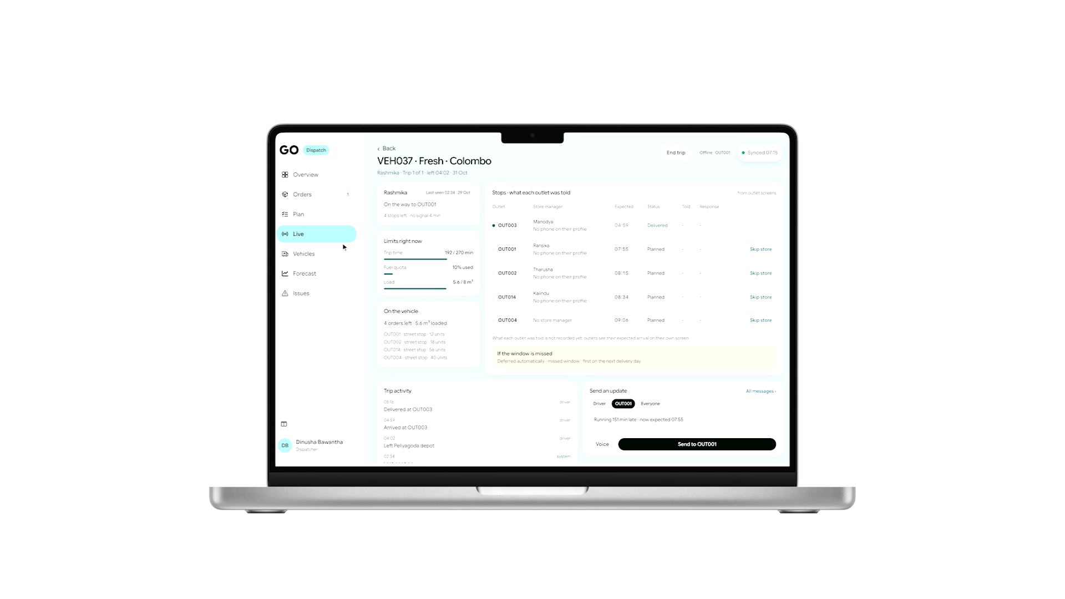
B
One room for the whole trip
The dispatcher, the driver,
every store on it
One picture, live, for
everyone
GO asks, and suggests
the next step
A person decides
Notes:
So every trip gets one room. The dispatcher, the driver and every store manager on that trip, in one conversation, live. GO takes part: it asks the stores and suggests the next step. But a person decides.

Slide 22
B
One room for the whole trip
The dispatcher, the driver,
every store on it
One picture, live, for
everyone
GO asks, and suggests
the next step
A person decides

Slide 23

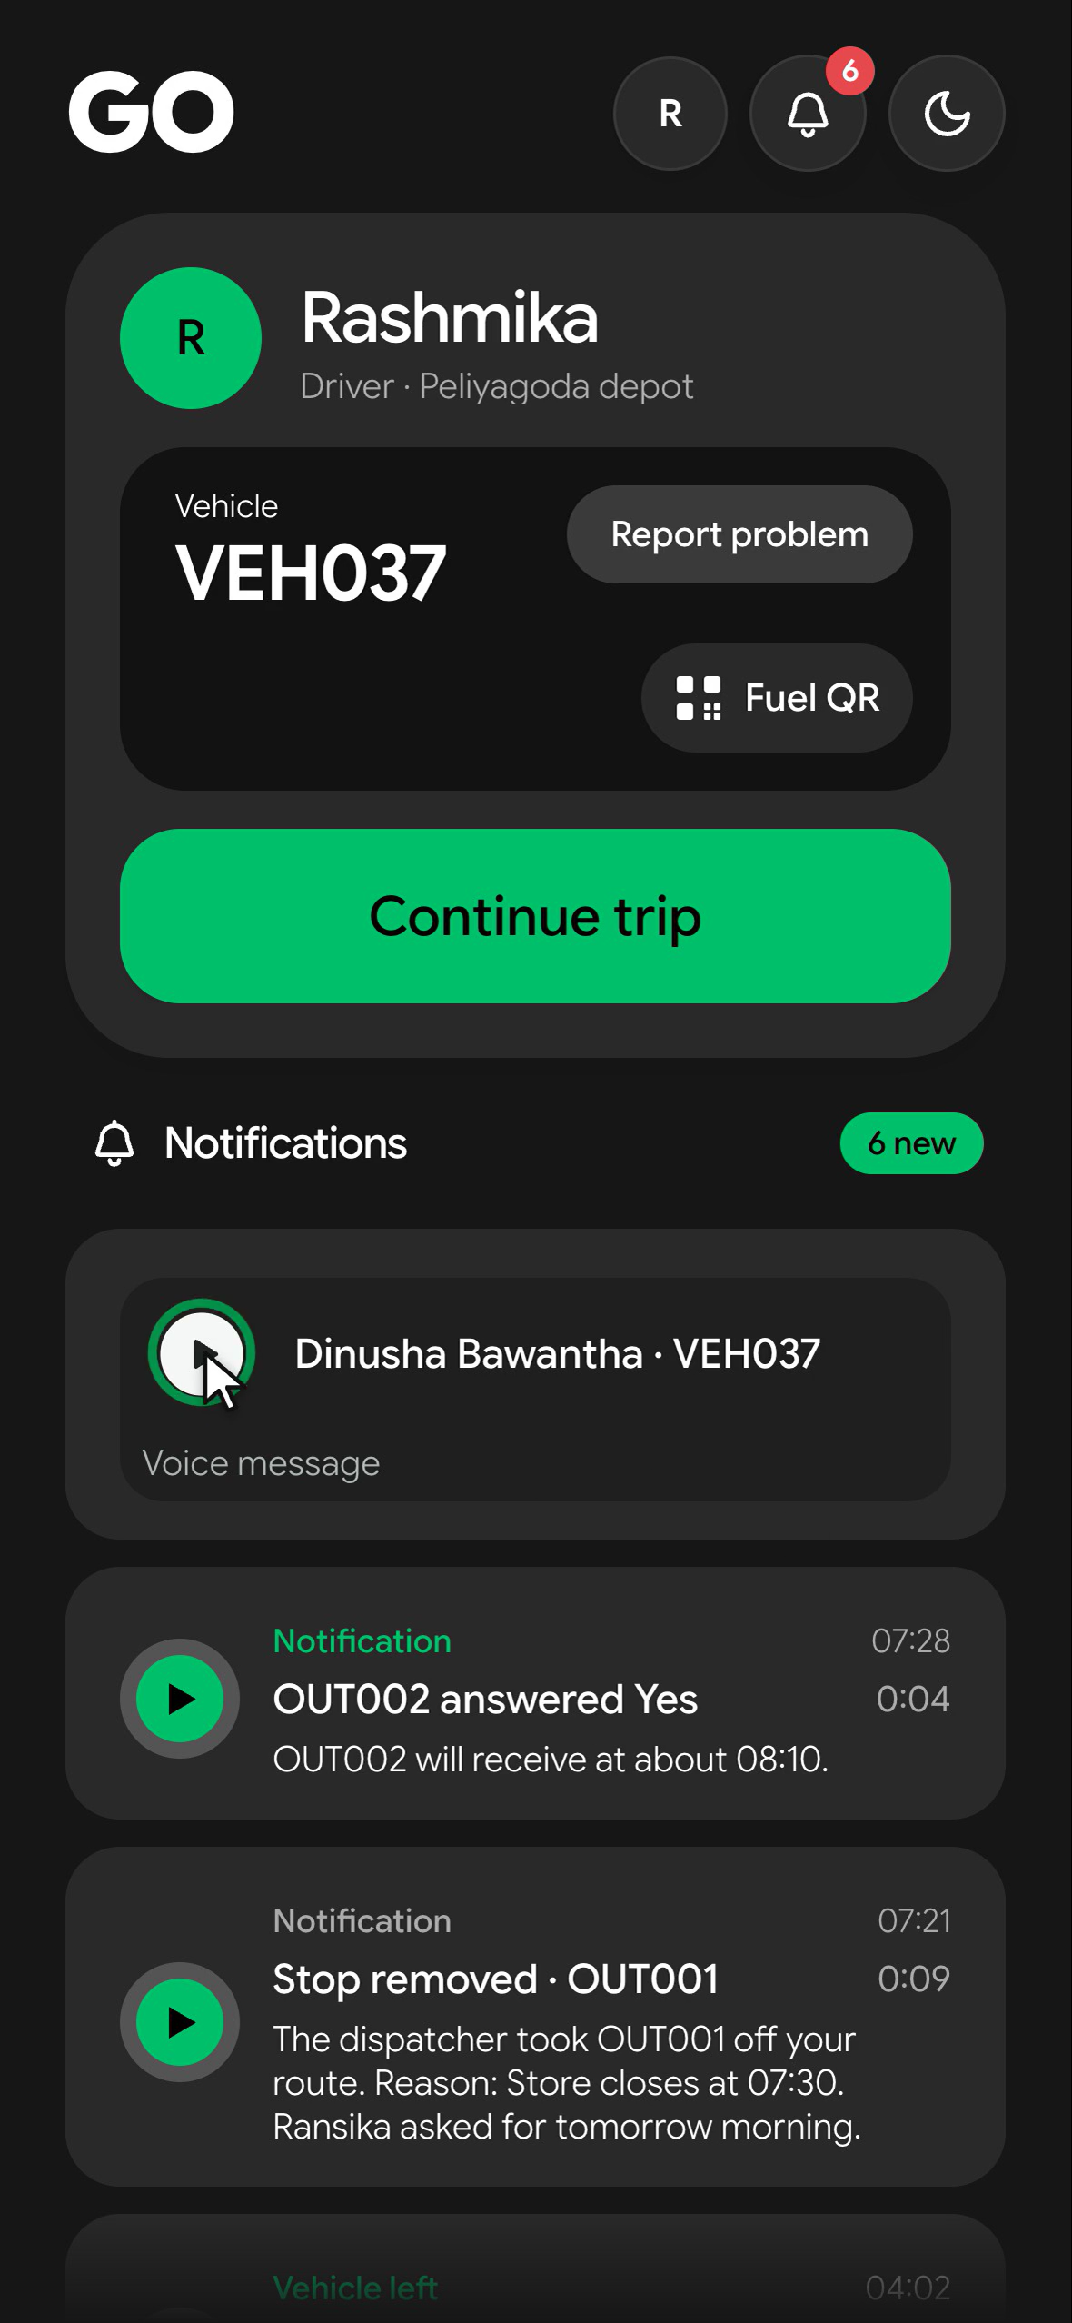
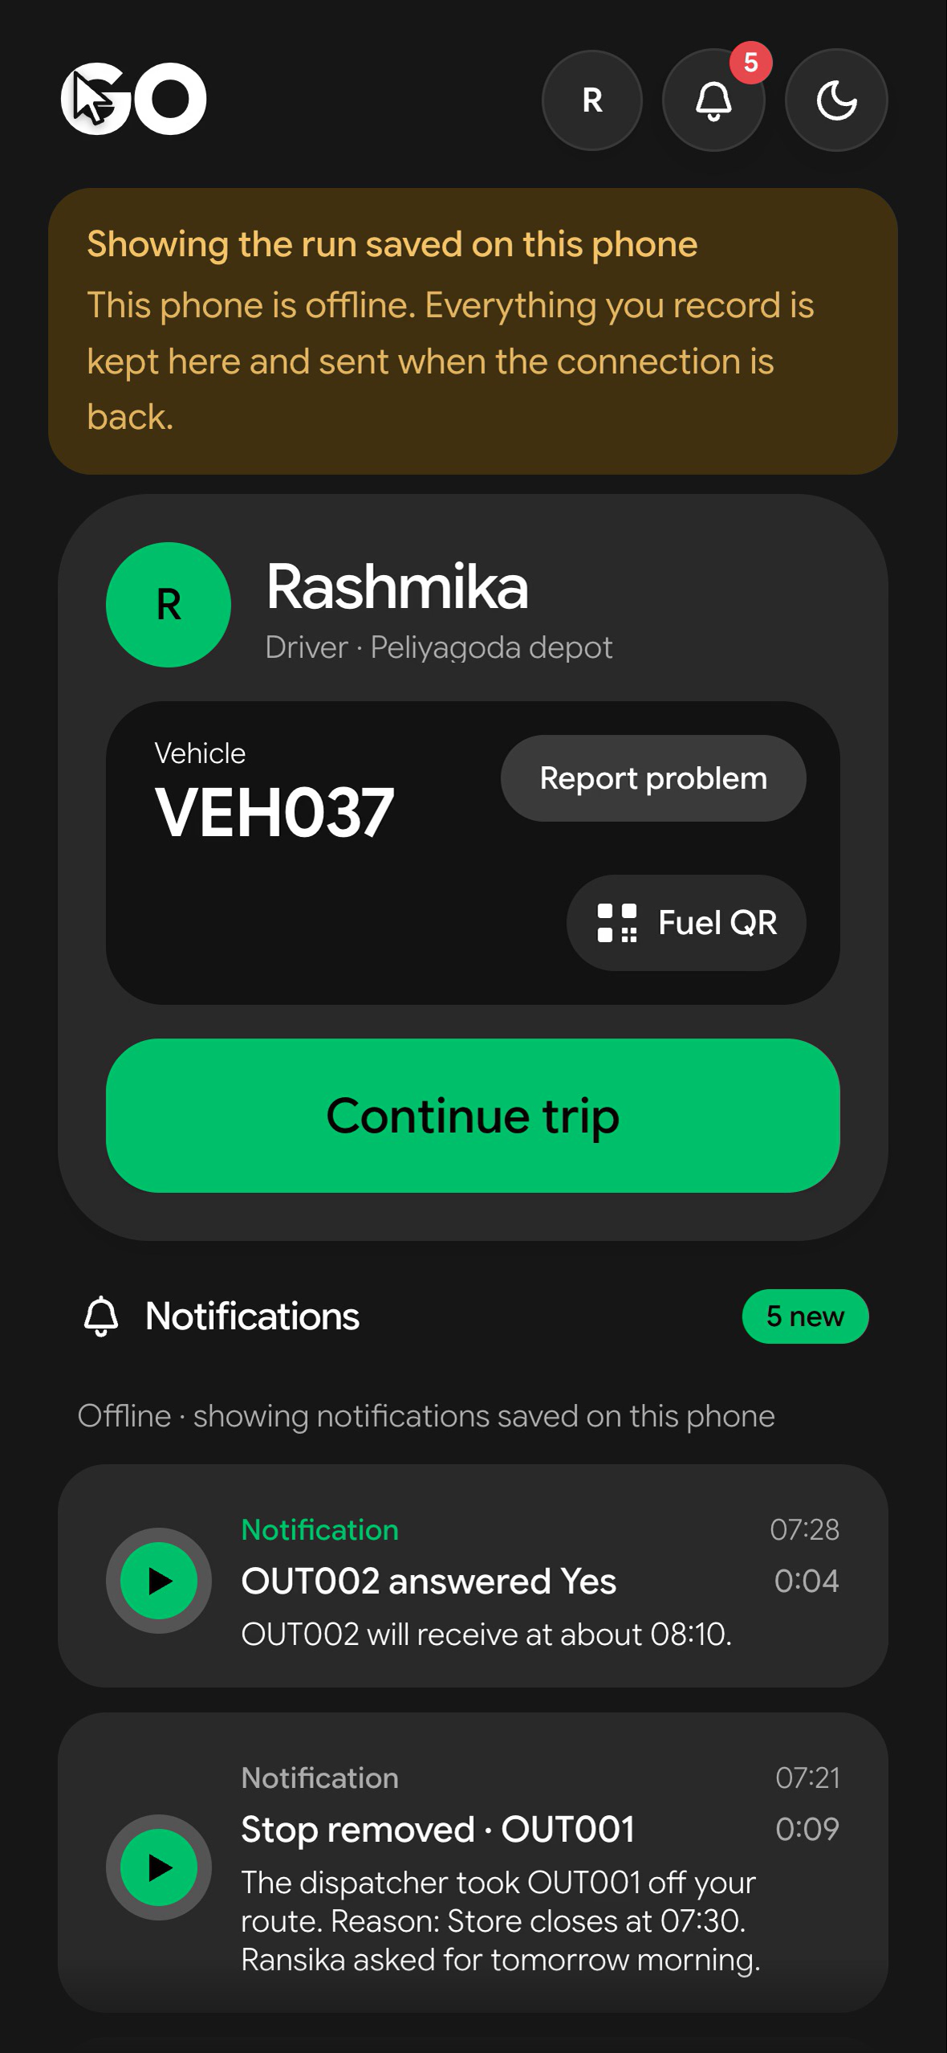
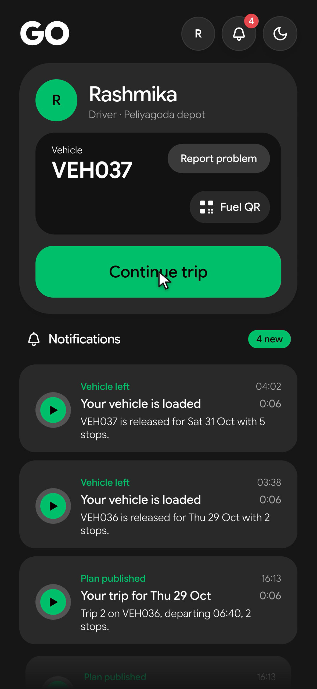
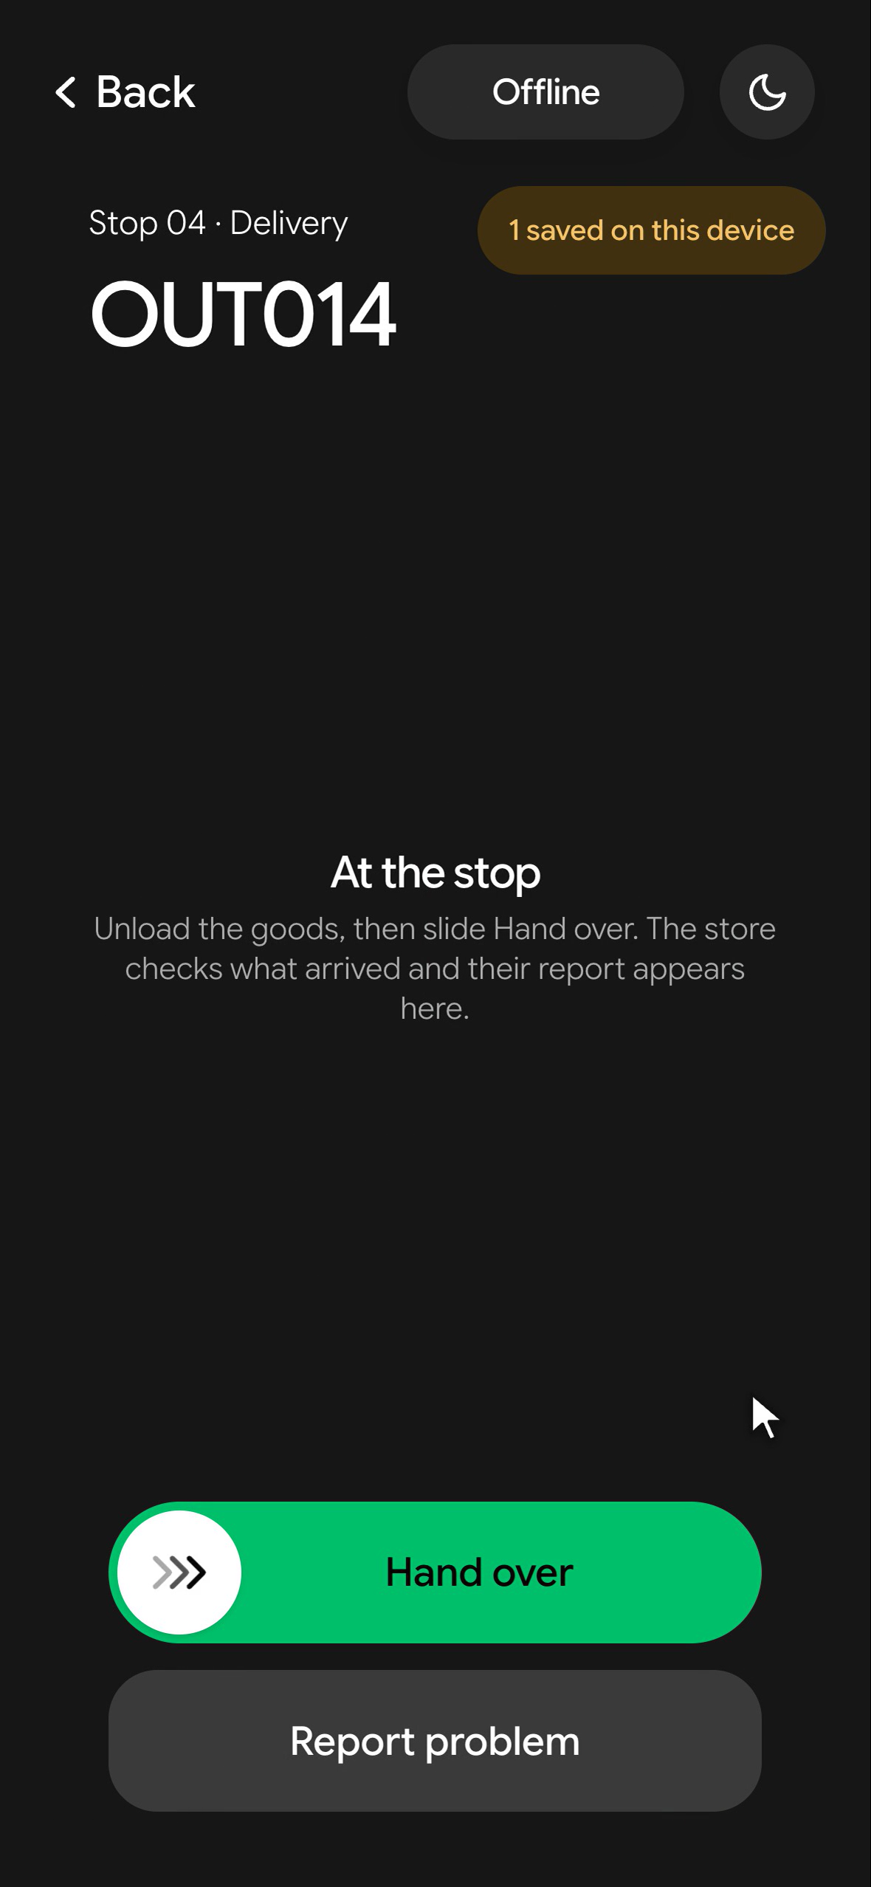
Made for the driver
Works with no signal
the day's trip on the phone; proof sent when signal returns
Dark screen while driving
nothing to read, nothing to tap
Fuel QR, even offline
the fuel pass works at the pump with no signal
Next stop, one action
Voice notes to listen to, not read
Notes:
For the driver, the first rule is that GO works with no signal. The day's trip is on the phone before the van leaves; deliveries, photos and signatures are sent when the signal returns. While the van moves, the screen goes dark: nothing to read, nothing to tap. The Fuel QR, the pass every vehicle needs at the pump, works even offline. When the van stops: the next stop, one action. And anyone can leave the driver a voice note, so the driver listens instead of reading.

Slide 24
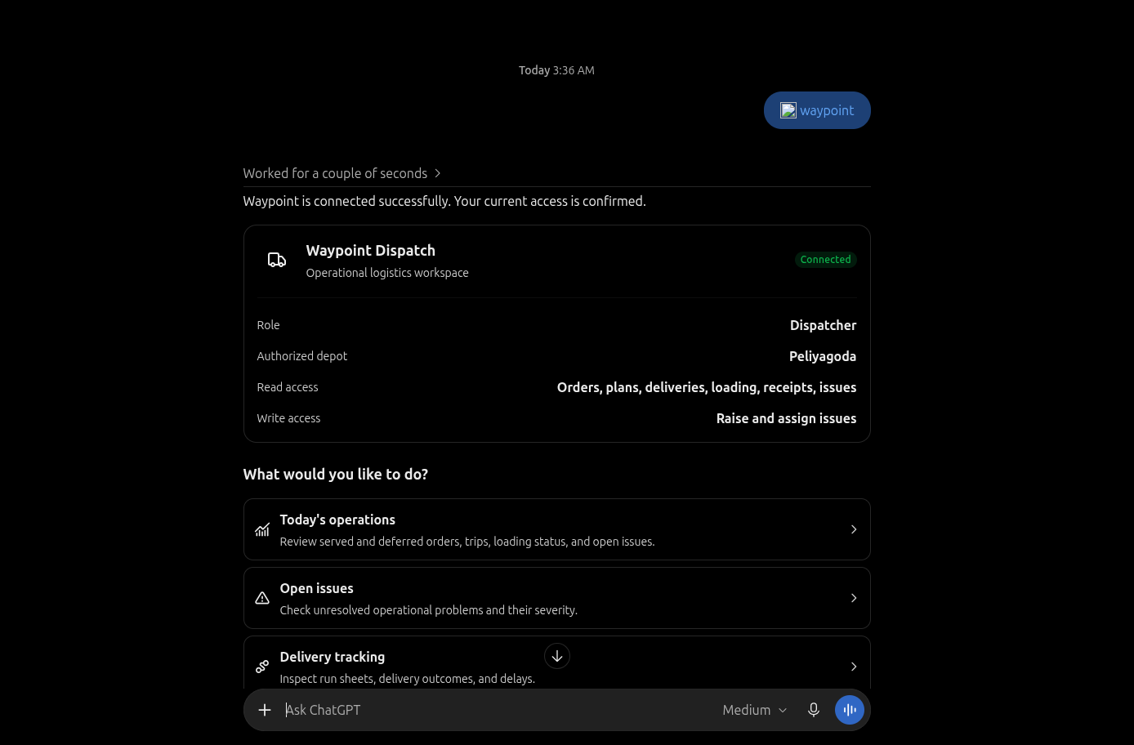
Ask GO with your own AI
MCP: connect your own AI
"Which trips are at risk this morning?"
Reads the day, within their permissions
trips, plans, issues, the audit trail
Notes:
Two more tools. First, the dispatcher can connect their own AI assistant to GO through MCP, and simply ask: which trips are at risk this morning? What happened at store forty-two yesterday? It reads the day within the same permissions the dispatcher already has, and it never acts alone: even raising an issue waits for their confirm.

Slide 25
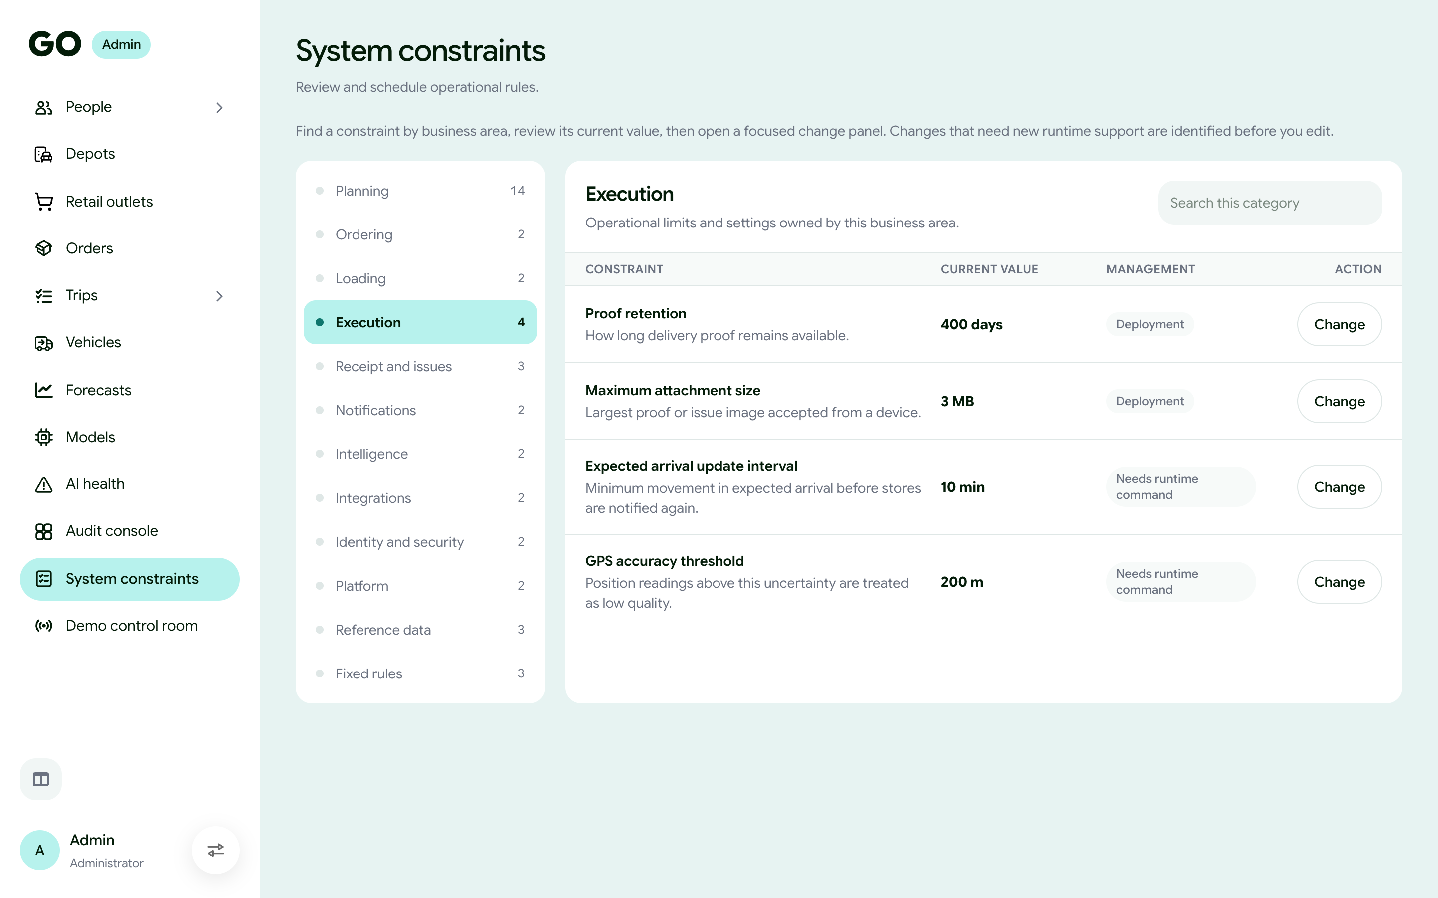
Designathon
Run the rules, without a developer
Designed for people
who start at 3 AM
MCP: connect your own AI
Users, roles and policies
"Which trips are at risk this morning?"
permissions written like a cloud console
Go Green
The next step to take · From our logo
Reads the day, within their permissions
Vehicles and planning
parameters
Teal
trips, plans, issues, the audit trail
changed without a new release
Decisions and links · Calm & trusted
Night
Never acts alone
Every change audited
Dark screens do for 3 AM · No glare in the cab
raising an issue still needs their confirm
who, what, when and why
Notes:
Two more tools. First, the dispatcher can connect their own AI assistant to GO through MCP, and simply ask: which trips are at risk this morning? What happened at store forty-two yesterday? It reads the day within the same permissions the dispatcher already has, and it never acts alone: even raising an issue waits for their confirm.

Slide 26



Designathon
Designed for people
who start at 3 AM
Go Green
One action per screen
The next step to take · From our logo
Teal
Slide to confirm
Decisions and links · Calm & trusted
Night
Sinhala · Tamil · English
Dark screens do for 3 AM · No glare in the cab

Slide 27
Hackathon

Slide 28
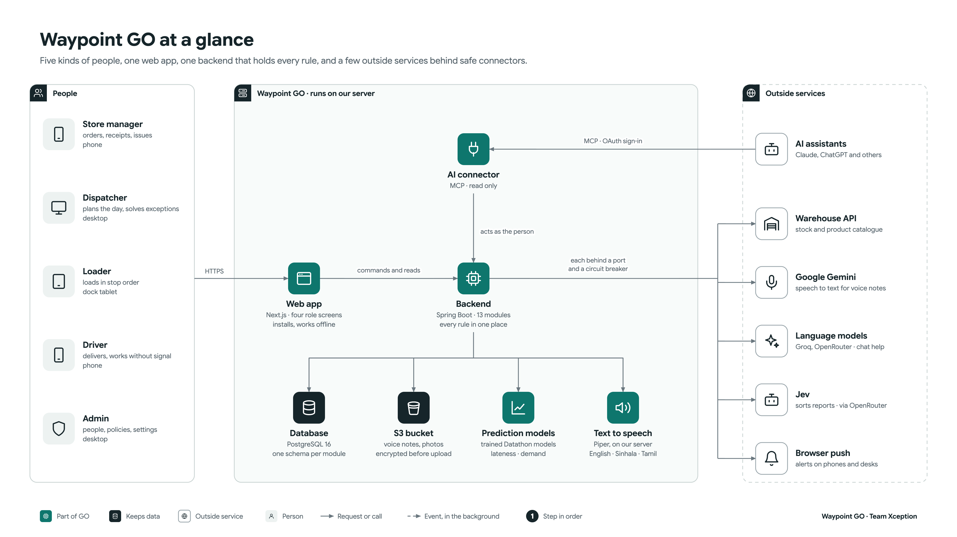

Slide 29
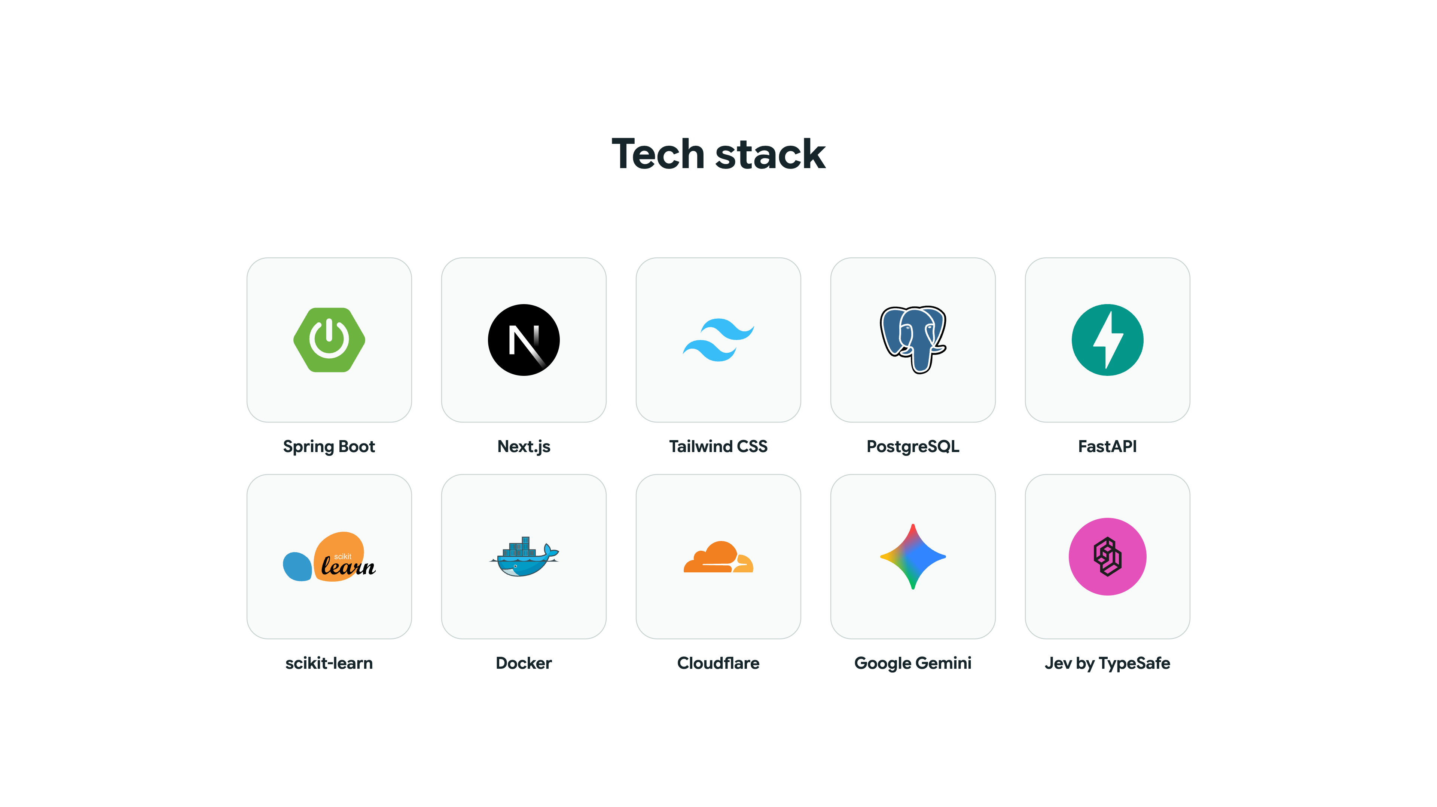

Slide 30
Datathon

Slide 31
Three kinds of intelligence, under one rule
Task 1
Task 2A
Task 2B + Live planner
Predict
Foresee
Decide
Which stops will be late, and how long unloading takes
Demand ten weeks ahead, as trucks, refrigerated trucks and drivers
The best plan when trucks run short, and why
Rules First
Our own models
Language AI, wording only
A person decides
If a model is ever down, GO falls back to a safe estimate and says so on screen

Slide 32
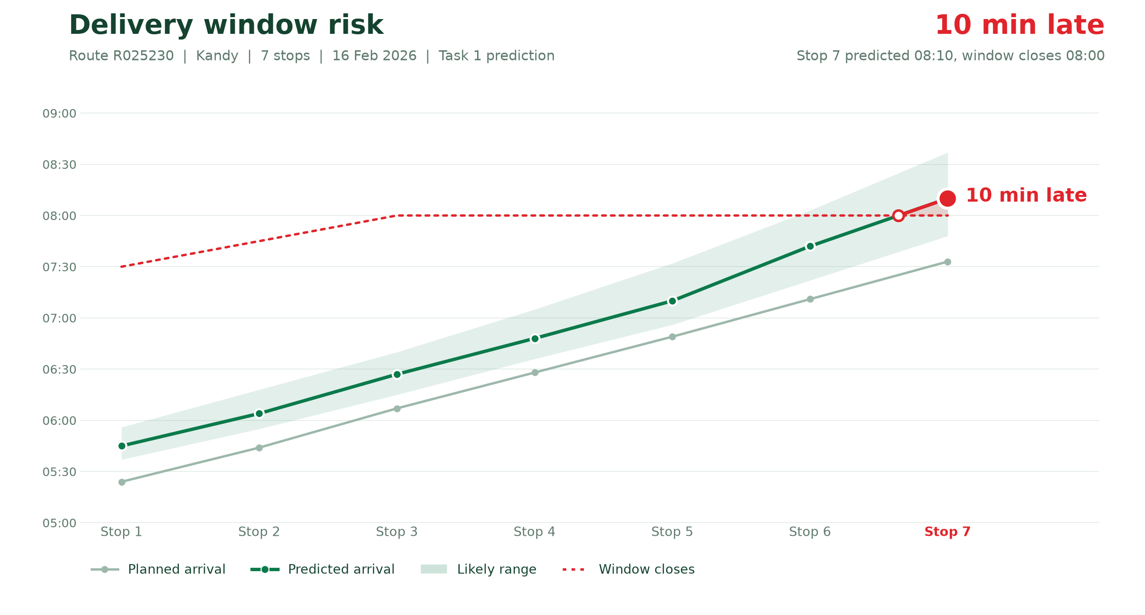
Task 1 · Predict
Late risk and unloading time, predicted before the truck leaves
How it predicts
Why it matters: delay builds along the route
Monte Carlo Simulator
Blend
Every stop
LightGBM
Lateness probability
Service time prediction
56
out of every 100
late deliveries
SAVED
< 4 min
unloading-time error
Staff ready
Dock ready
Gate ready

Slide 33
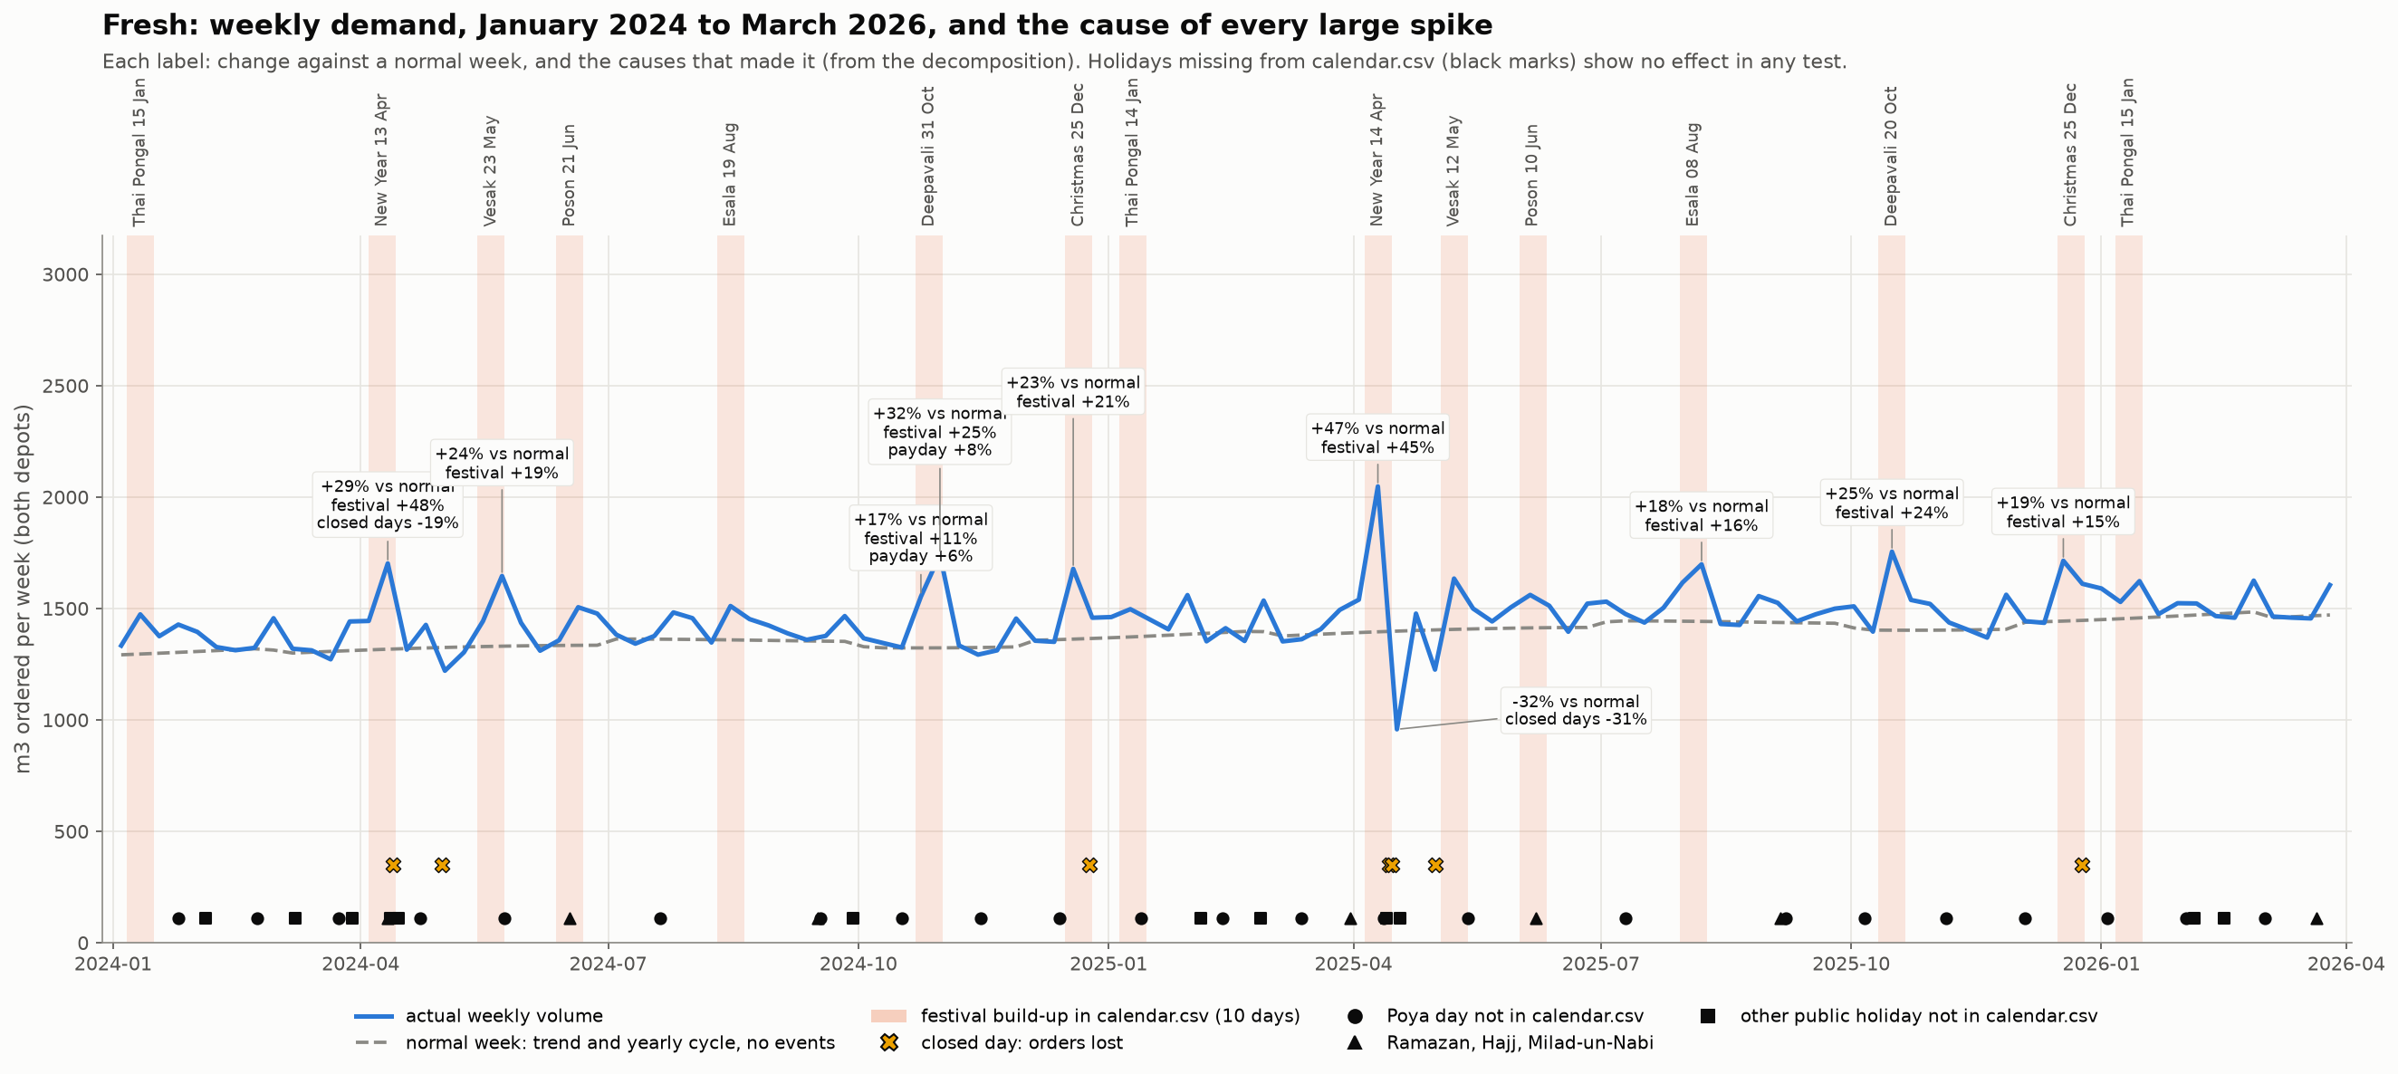
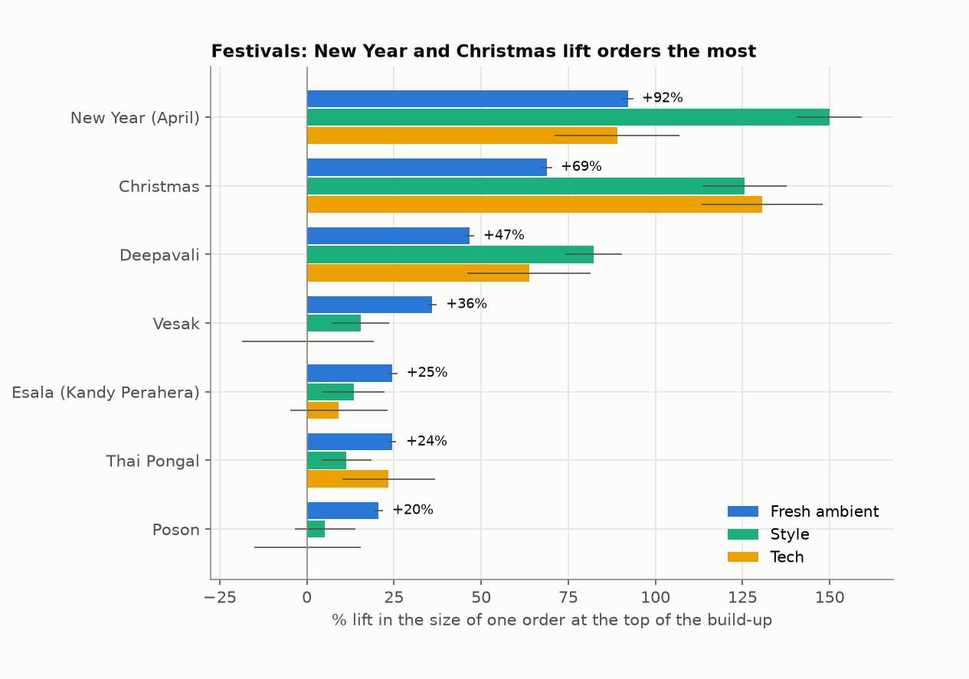
Task 2A · Foresee
Every demand peak has a cause
Weekly demand over two years, every peak labelled
Festival lift, measured per brand
How it forecasts
Orders per store
×
Size per order
=
Weekly forecast
Each cause becomes a forecast input
Festival ramps, payday, monsoon and season. Holidays with no lift are left out.
Orders: each store’s ordering days, from its history
Size: one model per load: Fresh ambient, Fresh chilled, Style, Tech

Slide 34
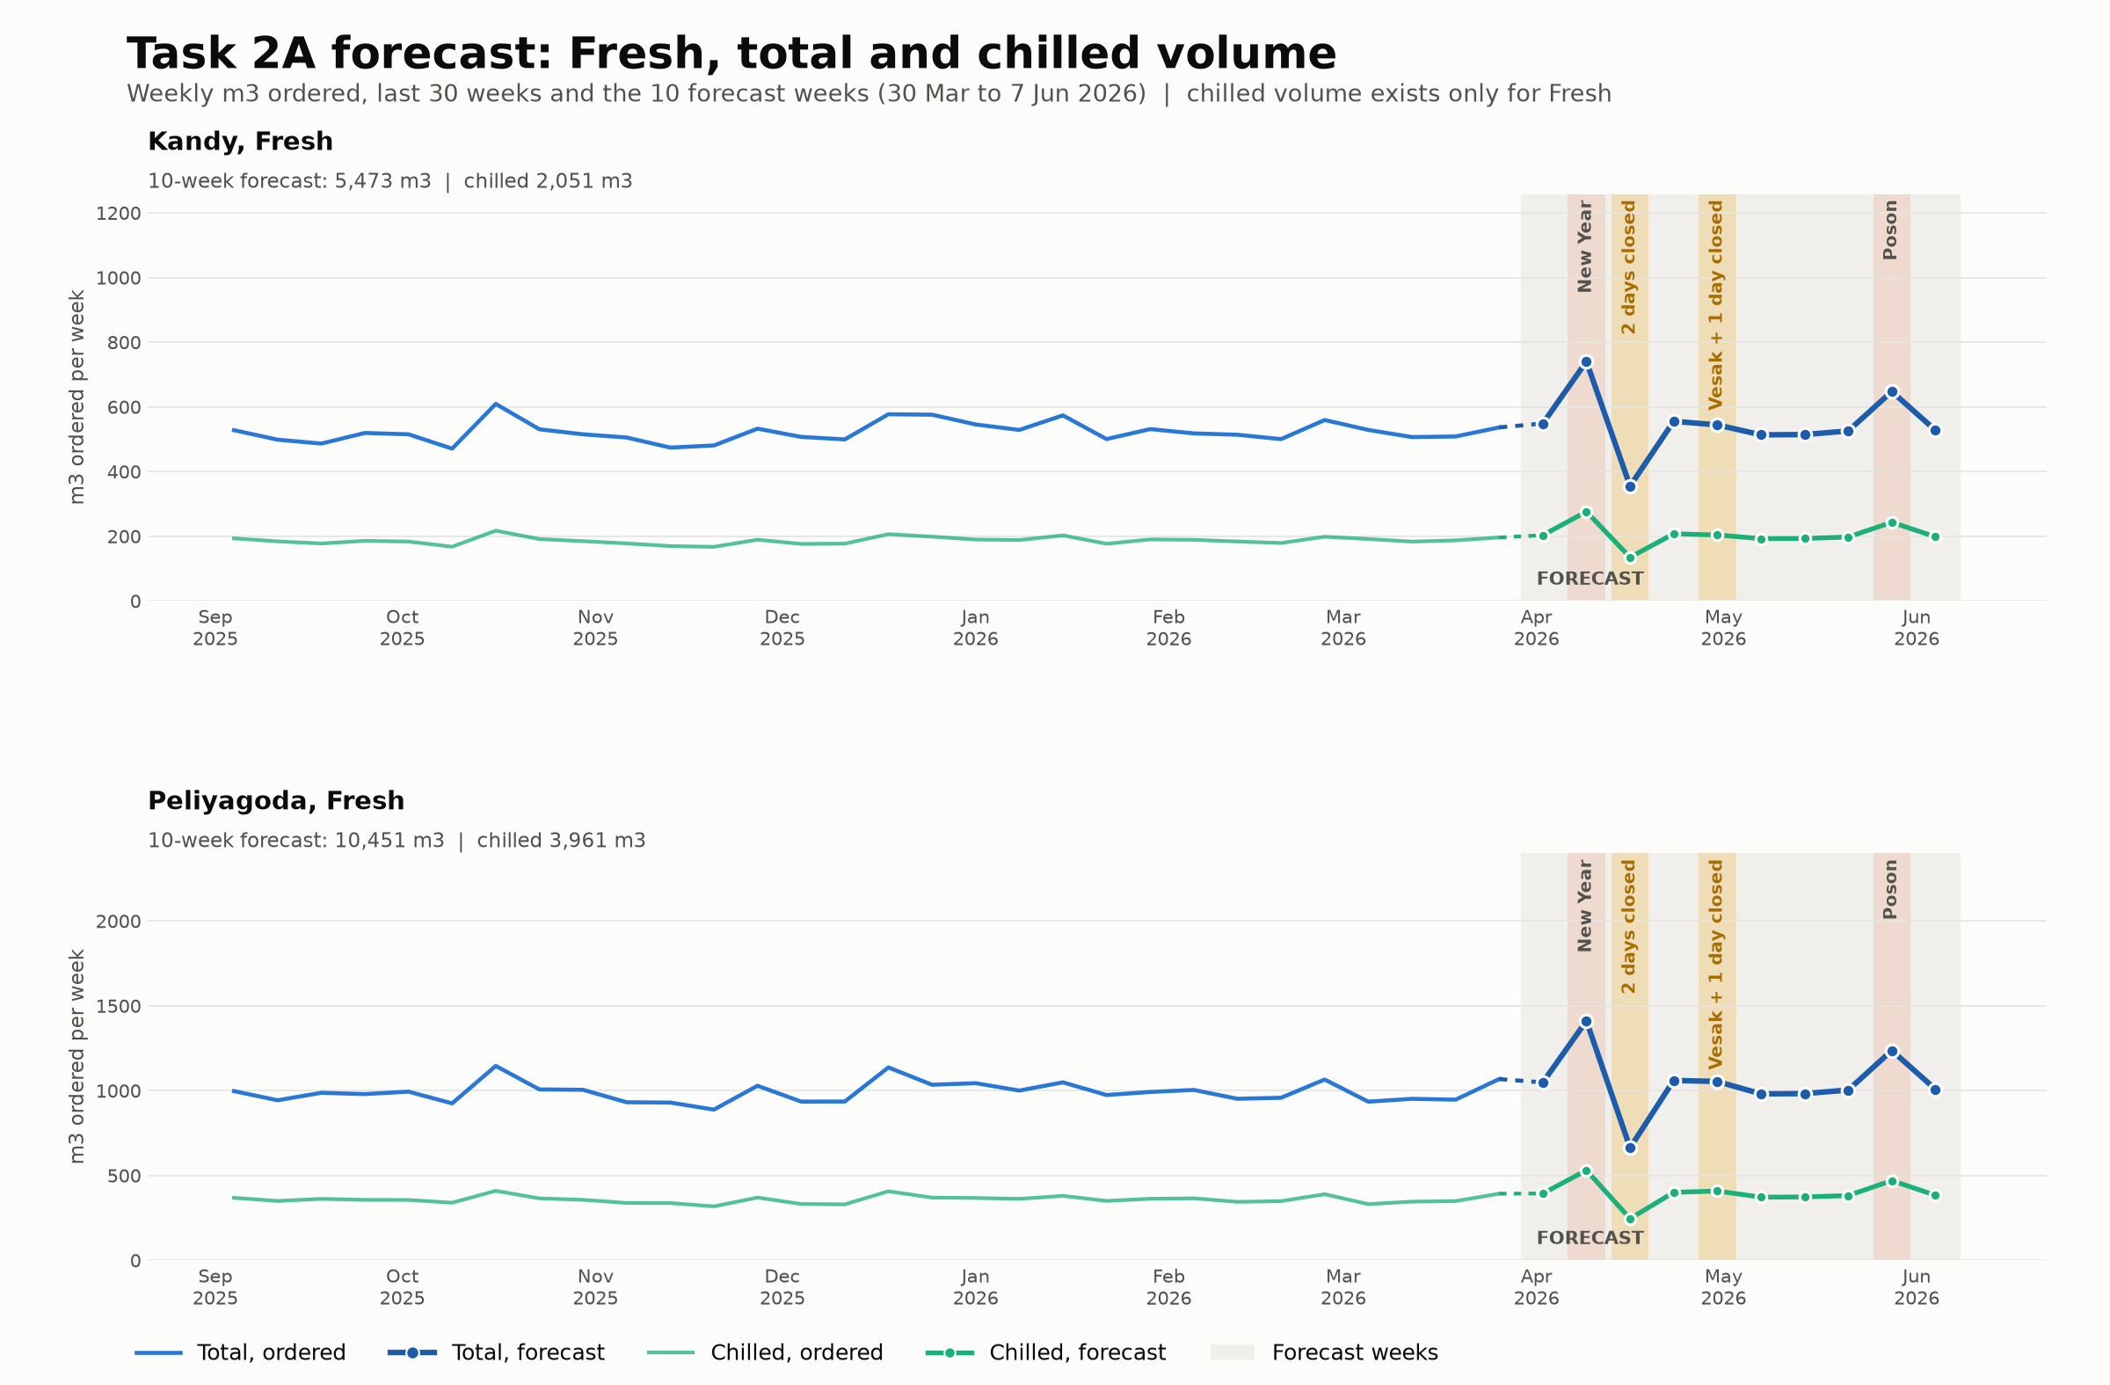
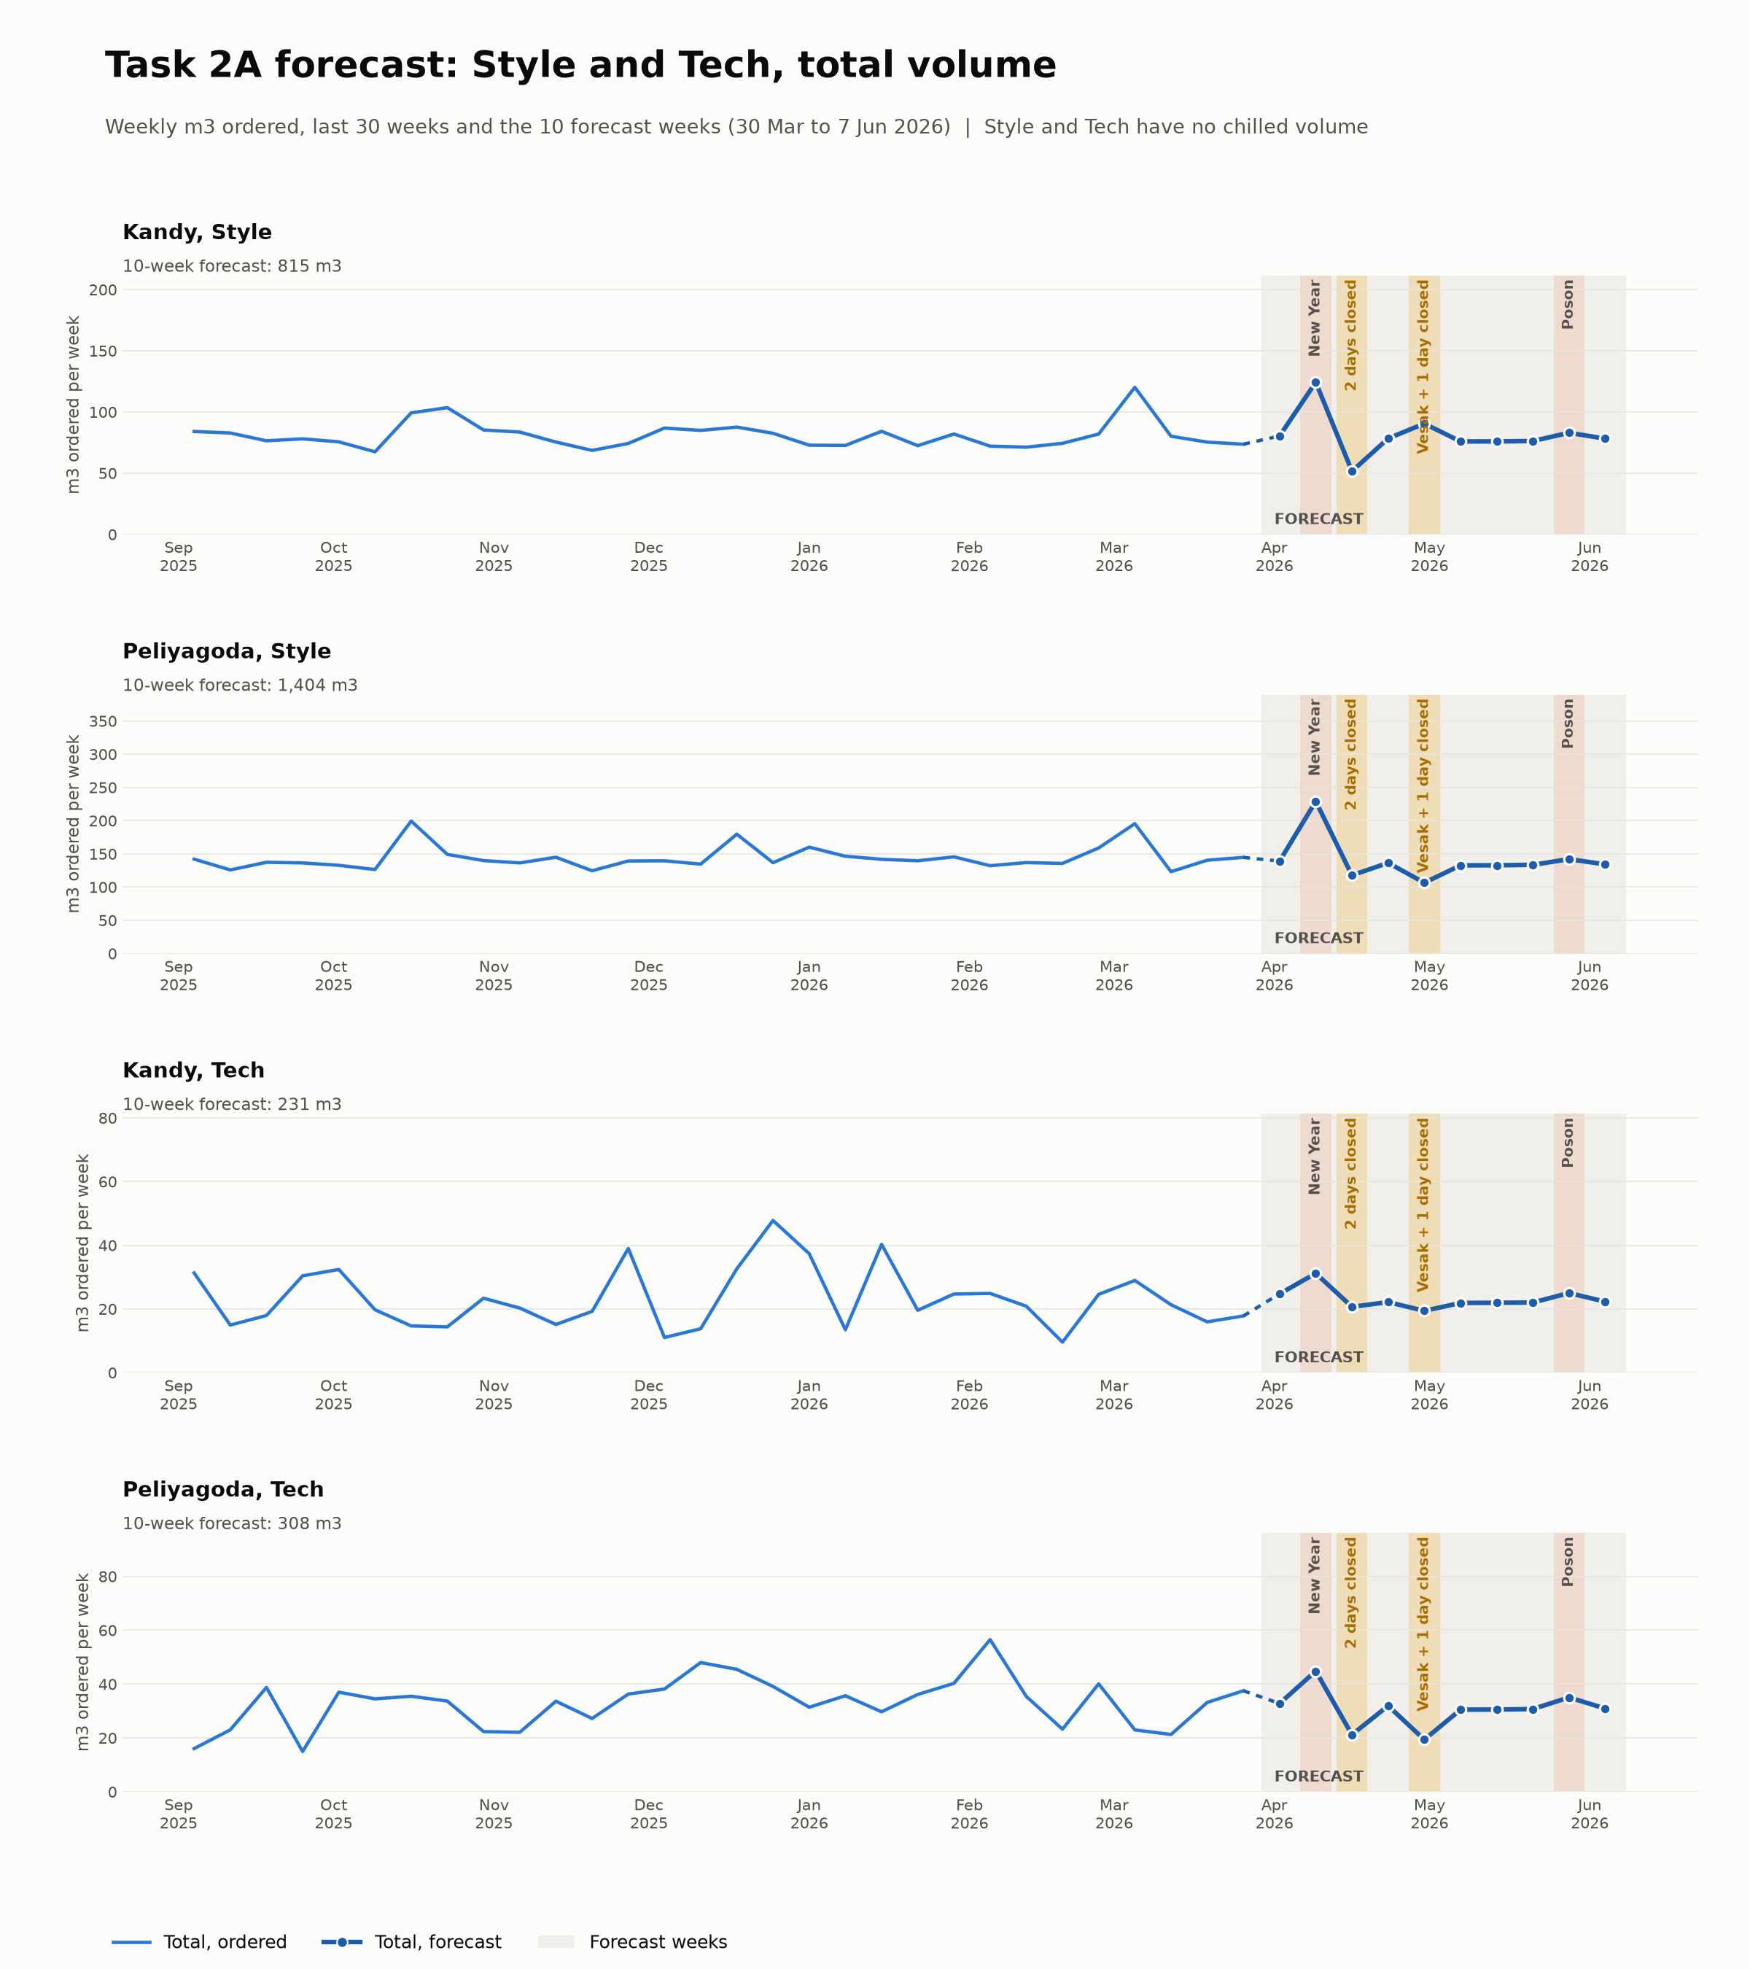
Task 2A · Foresee
Off by about 3%, ten weeks ahead
Fresh, by depot: total and chilled, m³ a week
Style and Tech, by depot: m³ a week
3%
Forecast error, ten weeks ahead
WAPE
Weighted Absolute Percentage Error

Slide 35
Task 2B · Decide
Priority Orders, Practical Plans
September 2025 simulation . 26 Operating Days . Daily averages
Conventional plan
GO planner
The existing approach used to organize deliveries
Our automated delivery planning system
81
Fresh orders
81
4
Impractical Plans
0
1
Deferred Recovery
2
572 L
Fuel Efficiency
564 L

Slide 36
MCP · Your own AI
Ask GO with your own AI
Connect Claude or ChatGPT through MCP and ask GO in plain words
Claude · ChatGPT
Read-only
“Which trips are at risk this morning?”
Your AI can look, never change.
Trips, plans, issues and the audit trail, only within the permissions you already have
GO answers from the day's records
Your permissions only
Every call audited
it sees only what that person can already see
who asked, what was read and when
By default, every AI connection is read-only.
Notes:
The dispatcher can connect the AI assistant they already use, Claude or ChatGPT, to GO through MCP, and simply ask: which trips are at risk this morning? GO answers from the day's records.
The key point: it is read-only. Your AI can look, but never change anything. It sees trips, plans, issues and the audit trail, and only what that person is already allowed to see. Names and notes are hidden unless an admin allows them, and every call is audited: who asked, what was read and when.
By default, every AI connection is read-only.

Slide 37
Business value
What changes for Waypoint
Four problems people live with today, and what GO changes for each
Today
Today
Today
Today
One spreadsheet, one person
Fresh misses 08:00
The peak is a surprise
Disputes rest on memory
With GO
With GO
With GO
With GO
More orders, same fleet
Fresh on shelves by 08:00
Hire before the peak
Nothing lost, nothing argued
every order checked against every rule; fewer trips and litres
late risk seen before the truck leaves
the forecast turns weeks into vehicles, reefers and drivers
every handoff on record, even with no signal
Four people, One app. Every handoff on record.

Slide 38

Any Questions?

Slide 39
Thank you!
Team |
Xception

Slide 40
Appendix
Click a topic to jump to it · every backup slide has an Index button to come back
12
How GO is built
19
Business case
13
The planning engine
20
Rollout plan and risks
14
Task 1 · Late risk and unloading time
21
Beyond Waypoint: market and revenue
15
Task 2A · Demand forecast
22
From design to product, and our honest limits
16
Task 2B · The peak-day plan
23
Engineering quality
17
Trust, safety and privacy
24
Numbers at a glance
18
Works offline, fails gracefully
Use these slides during Q&A only
Notes:
Backup index. Click a row, or type its number and press Enter, to jump to it. Each backup has an Index button to come back.

Slide 41
Backup
‹ Index
How GO is built
One web app for every role, a modular backend, and the models served beside it
People
›
Web app (Next.js PWA)
›
Backend (Spring Boot)
›
Data and models
Store manager · desktop or phone
PostgreSQL 16 · row-level security · 188 migrations
Four role workspaces
14 modules, from ordering to intelligence
Dispatcher · desktop
Model service (FastAPI): late risk + demand
Offline queue, replayed exactly once
One command path: permission check + audit
Loader · shared tablet, PIN
Checksums and file scan; fallback estimate if down
Service worker and caches
Events and a live change stream
Driver · phone, offline
Language AI gateway: off by default, masked, capped
Sinhala, Tamil, English
AI assistants · Claude, ChatGPT via MCP
Runs on one server (≈ LKR 19,000 a month) with Docker Compose · Prometheus, Grafana, Loki and alerts · tests on every pull request
WayPoint |
GO
12
Notes:
Architecture. One responsive web app (PWA) for all roles; Spring Boot modular monolith; PostgreSQL with row-level security; FastAPI model service with checksums and a fallback; optional language-model gateway; MCP for AI assistants; one VPS, Docker Compose.

Slide 42
Backup
‹ Index
The planning engine
Every order checked against every rule; people make the final call, with a reason
Step
What happens
Check
13 checks per order
1 · Place
Orders placed in priority order; earlier deferrals first (9 rules)
Vehicle
available, home depot, refrigerated, van-only
2 · Re-plan
reefers
Refrigerated vehicles planned again as a whole; kept only if better
Trip
one brand and district, one temperature
3 · Optimise
Same orders on fewer vehicles, trips and litres (1 vehicle, 3 trips, 15 L saved)
Capacity
weight and volume, no split orders
Time
delivery window, 2 trips a day, Fresh 270 min
4 · Decide
Dispatcher places by hand, swaps or keeps deferred, always with a reason
Fuel
weekly quota per vehicle
5 · Publish
Every rule checked again; loaders, drivers and stores are told
Explanations come from the engine, not guesswork. Each waiting order shows the rule that stopped it, what was fine, where it could go, the closest it came and the smallest change. A what-if re-runs the day with one more vehicle without changing the plan.
Why 72 in the app and 77 in the Datathon? The app also enforces every store’s delivery window and fuel quota; the Datathon plan used the booklet’s time budgets, where 3 stops arrived 16 to 87 minutes late.
WayPoint |
GO
13
Notes:
Why 72 in the app and 77 in the Datathon? The app also enforces each store’s delivery window and fuel quota; the Datathon plan used the booklet’s time budgets and let 3 stops arrive 16 to 87 minutes late. Both are correct for their rules.

Slide 43
Backup
‹ Index
Task 1 · Late risk and unloading time
Labels built from the route records; a simulator and LightGBM, blended
6 unseen weeks
Statistical
LightGBM
Ensemble
Selected
Service time = leave − later of (arrival, window open)
Unloading error (min)
5.24
3.75
3.66
3.72
Late = arrival after the window closes
Simulator: hundreds of runs per route, delays carried stop to stop
Late log-loss
0.302
0.133
0.125
0.131
Correct at 0.5
85.8%
94.5%
94.6%
94.5%
Blend in log-odds: 50/50 for lateness, 55/45 for minutes
False alarms
368
115
89
95
Training time
0.01 s
18 s
16 min
1.5 min
Caught 488 of 678 late; 84% of flags right
Per order / size
–
–
2 s · 33 MB
48 ms · 9.7 MB
Why the selected model? Within 0.06 minutes of the best, 10 times faster to train than the ensemble, one library, 48 ms per order. In production it must first beat the built-in estimate on our own deliveries (backtest and trust gates).
0.976
0.957
AUC: a late stop ranks riskier 97.6% of the time
AUC with no road data (production figure)
WayPoint |
GO
14
Notes:
Labels: service time = leave time minus the later of arrival and window open (waiting is not service). Late = arrival after the window closes. Holdout: last 6 weeks in date order. Without road conditions (as at planning time) AUC is 0.957: the honest production figure.

Slide 44
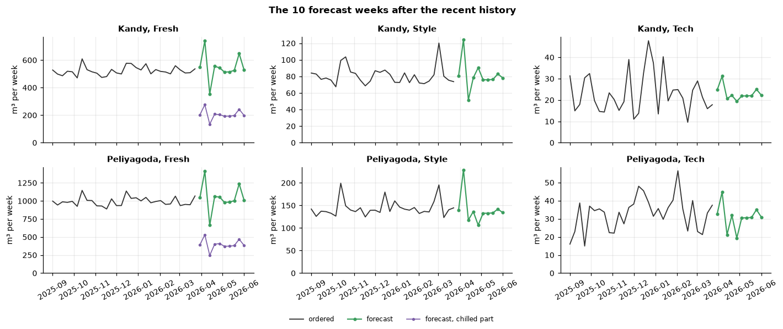
Backup
‹ Index
Task 2A · Demand, seen ten weeks ahead
WayPoint |
GO
15
Notes:
WAPE = total absolute error divided by total actual volume. 15 selection starts, 6 test starts, then the latest 6 weeks. Regression chosen: simplest of the statistically tied models (Diebold–Mariano with Holm). Tech is the weak spot (about 30%), but it is 3% of volume.

Slide 45
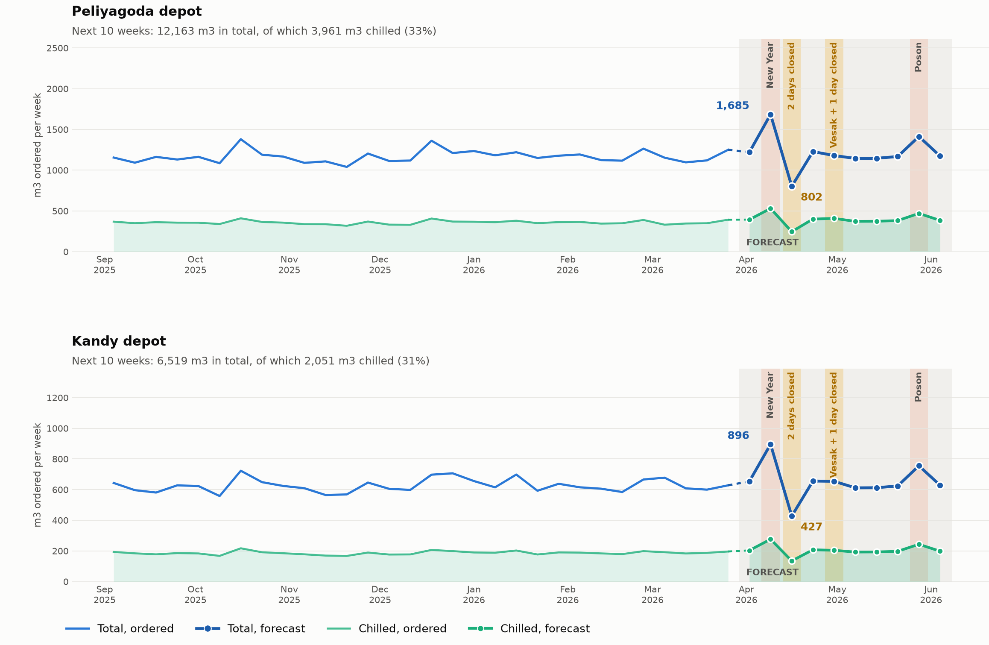
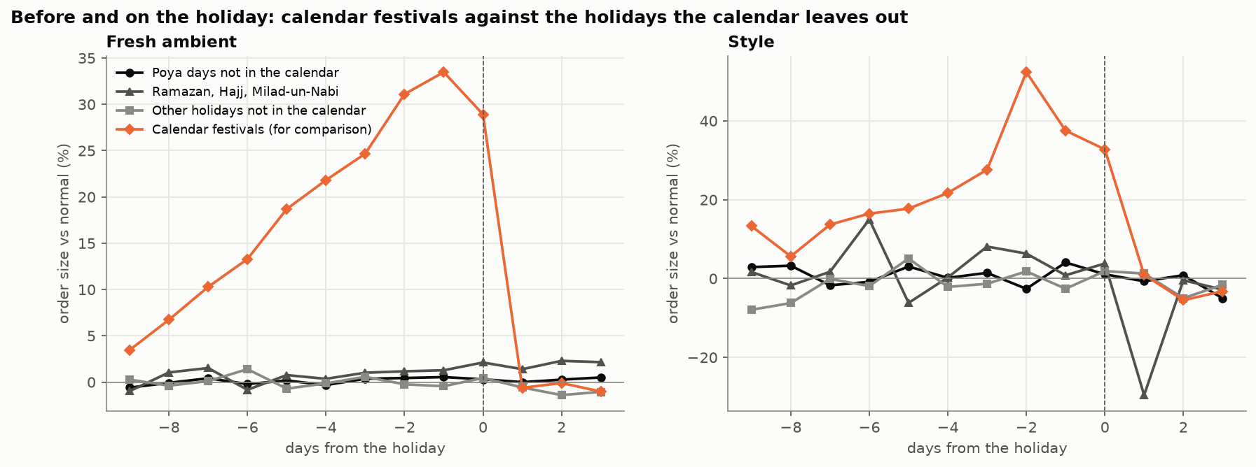
Backup
‹ Index
Task 2A · Demand, seen ten weeks ahead
Weekly forecast per depot, total and chilled, m³
Holidays not in the calendar: no lift
WayPoint |
GO
15
Notes:
WAPE = total absolute error divided by total actual volume. 15 selection starts, 6 test starts, then the latest 6 weeks. Regression chosen: simplest of the statistically tied models (Diebold–Mariano with Holm). Tech is the weak spot (about 30%), but it is 3% of volume.

Slide 46
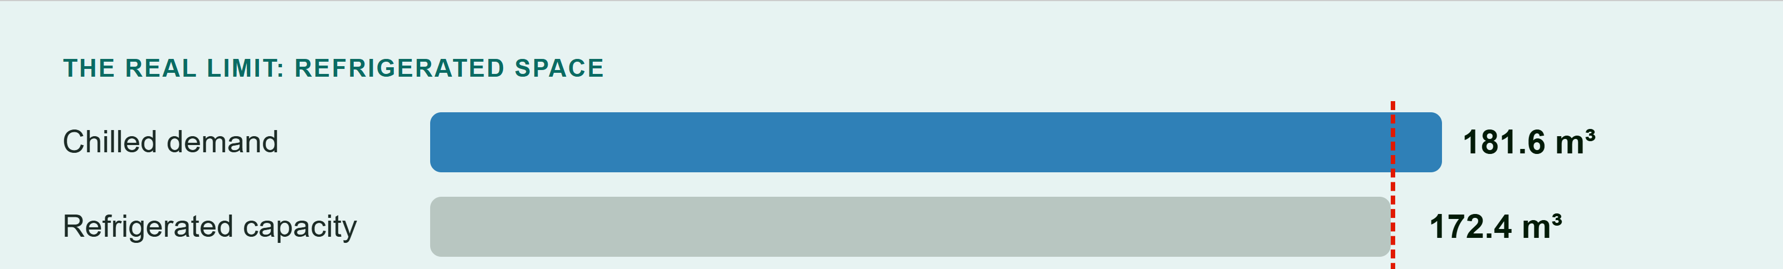
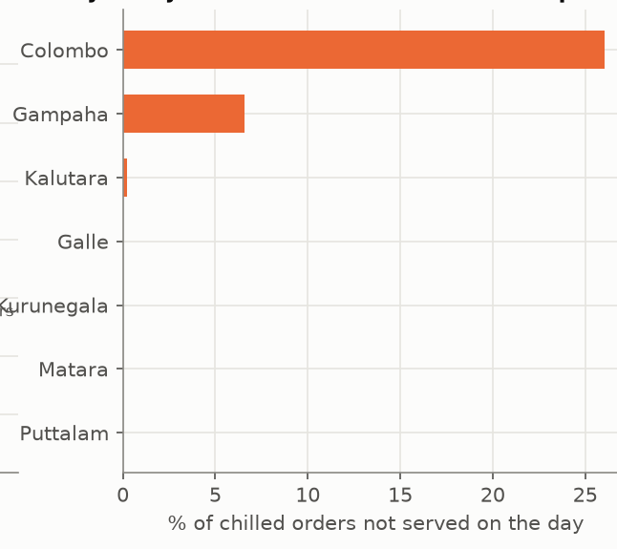
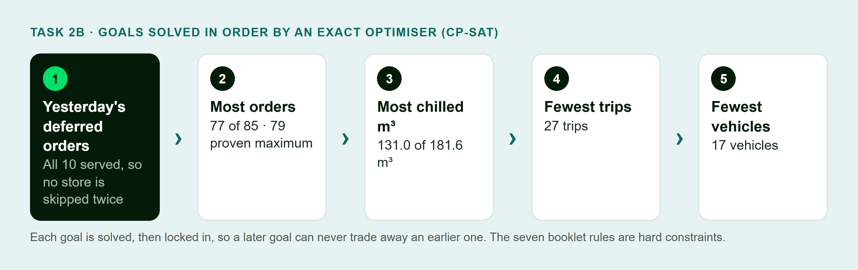
Backup
‹ Index
Task 2B · The peak-day plan
Too few trucks? The best plan, explained
Where chilled orders wait
Yesterday's deferrals go first, then as many orders as fit. Every order left waiting comes with a reason the dispatcher can give the store.
4 of 9
reefers on the road; 5 in the workshop
WayPoint |
GO
16
Notes:
Six deferrals were unavoidable (one order bigger than any vehicle and five chilled orders with no reefer room or time). Two were a choice: serving yesterday’s deferred orders first cost 2 orders and 9.76 m³. Recommendation: release VEH004 and VEH005.

Slide 47
Backup
‹ Index
Trust, safety and privacy
Advice, never autopilot; every AI answer checked; every action audited
Models
Language AI
Access and data
Predictions are advice: they never change a plan
Off by default; a daily call cap
Role + depot, store or vehicle scope on every request
Trust gates before going live: precision ≥ 60%, recall ≥ 70%, calibrated
Only allow-listed facts are sent; names masked
Row-level security in the database
Any number not in the facts → the plain sentence stands
Every command and AI call audited
Outcomes recorded, daily metrics, drift alerts
Zero retention; prompt version logged
Sessions 12 h, 2 h idle; login throttling
Shadow candidate on every plan; worse model rolled back
An outside AI (Jev) sorts problem reports, in shadow only
AI assistants (MCP): own permissions, confirm-before-change
Competition models off in production until own-data model passes
Ready for Sri Lanka’s PDPA (in force 1 January 2027): data agreements before any cloud AI, hosting in Sri Lanka as an option
WayPoint |
GO
17
Notes:
Production keeps competition-trained models off (ML_ALLOW_DATATHON=false) until a model trained on Waypoint’s own deliveries passes the backtest. The language-model gateway is off by default and only rewords facts the system already holds.

Slide 48
Backup
‹ Index
Works offline, fails gracefully
Designed on Day 5 as our failure screen; built and working today
Driver, loader and store keep working with no signal
If this fails…
GO keeps going
Mobile signal
Queue on the phone, sync later
Warehouse API
Orders kept as ‘stock not checked’
1
Saved on the phone with a command ID; sent exactly once
Model service
Built-in estimate, labelled
2
Survives a reload or an expired session
Language AI
‘Suggestions: rules only’
3
‘Saved on this device’ is shown apart from ‘confirmed’
Push service
In-app notifications
Vehicle breakdown
Driver reports it; plan revised
4
Conflicts are flagged for review, never overwritten
WayPoint |
GO
18
Notes:
Every action is saved on the device with a command ID and replayed exactly once. A reload or expired session keeps the queue. Conflicts show as Needs review; nothing is silently overwritten.

Slide 49
Backup
‹ Index
Business case
Team estimate from public data, 5 Oct 2026; rows are rounded
LKR million a year
Low
Expected
High
Option, 3 years
Cost and gap
Fuel, better loads
4.5
11.0
20.0
Waypoint GO
≈ LKR 20.3m all-in; full scope
Fresh before 8 AM
2.2
6.0
13.9
Routific
LKR 6.6–8.5m; route planning only
Fewer vehicle-days
1.4
2.7
5.4
Damaged-goods write-offs
1.2
2.4
3.6
Shipday
≈ LKR 19.4m; gaps below
Festival hires avoided
0.5
1.1
1.8
Onfleet Enterprise
LKR 36.7m+; gaps below
Fuel-log reconciliation
0.5
1.1
2.7
Track-POD
LKR 34.8–63.0m; gaps below
Planning, calls, paperwork, disputes
1.2
2.3
3.5
Every bought option also needs ≈ LKR 6.2m of integration, and none covers multi-brand allocation with explained deferrals, reefer/van/mall rules, offline Sinhala and Tamil, store receipt and disputes, the Fuel Pass quota, or data kept in Sri Lanka.
Total
11.5
26.5
50.8
Costs: build LKR 8.2–11.8m · run ≈ LKR 19,000 a month · maintain ≈ LKR 3.3m a year · 3-year total ≈ LKR 20.3m · payback 11 / 5 / 3 months (low / expected / high) · 3-year value ≈ 3.9× cost; expected net gain ≈ LKR 59m
WayPoint |
GO
19
Notes:
Fuel and Fresh on time are about 64% of the expected value, so the pilot measures those first. Labour savings are small because wages are low. Hosting and AI services are billed in US dollars; they are converted at LKR 328 per US dollar (5 Oct 2026).

Slide 50
Backup
‹ Index
Rollout plan and risks
22 weeks with 4 engineers; the critical path is collecting real outcomes, not code
Weeks
Work
Risk
Answer
1
Hygiene and safety: secrets, backups, restore drill
Drivers don’t adopt
Depot champion, induction card, paper fallback
2–3
Baseline: today’s KPIs measured
Models not trusted
Shadow first, trust gates, reasons on every flag
3–5
Quick wins: early capacity plan
5–9
Foundation fixes
Data protection (PDPA)
Agreements and masking before any cloud AI
6–13
Kandy pilot: 4 weeks shadow, 4 weeks live
New AI vendor
Behind our own interface, pinned version, rules fallback
10–17
Field features
≈ 19
Model trust gates on real deliveries
Exchange rate on cloud costs
Invoice in LKR with yearly indexation
17–22
AI features, after go/no-go and data agreements
Pilot success: Fresh before 8 AM +5 points · calls −30% · write-offs −20% · 90%+ of stops in the app · zero cross-store data leaks · zero lost delivery records
WayPoint |
GO
20
Notes:
Owners: business owner funds each phase gate; Head of Distribution decides the pilot go/no-go; Finance owns write-off thresholds, fuel and the data licence; the engineering lead owns technical gates.

Slide 51
Backup
‹ Index
Beyond Waypoint: market and revenue
Waypoint is the reference customer; the same platform fits other fleets
Tier
Per vehicle a month
Includes
Core
LKR 4,900
Dispatch, offline driver app, proof of delivery, store receipt, Sinhala and Tamil
Pro
LKR 8,200
Core + constrained allocation with explained deferrals, reefer windows, fuel quota, issues
Enterprise
LKR 13,100
Pro + arrival times, late risk and forecast, capped AI, single sign-on, hosting in Sri Lanka
Year
Customers
Vehicles
Revenue
LKR 525m
≈ 95%
Next
1
5
125
LKR 14.4m
a year within reach: ≈ 300 chains, manufacturers and distributors with 10+ vehicles (≈ 6,000 vehicles)
gross margin on subscription (≈ LKR 330 per vehicle a month); min. 10 vehicles; setup LKR 1.0–4.9m
Prerequisite: multi-tenancy, decided after the pilot proves the value
2
14
420
LKR 42.0m
3
28
980
LKR 90.9m
WayPoint |
GO
21
Notes:
Before selling to anyone else, GO needs multi-tenancy (row-level security is per person today, not per customer company). That is a decision after the pilot.

Slide 52
Backup
‹ Index
From design to product, and our honest limits
The Figma file is the specification; every departure is documented
Design → product
What we state openly
Day 5 failure screen (‘proof saved with no signal’) is built and works
Models were trained on synthetic competition data; production retrains on Waypoint’s own deliveries first
All four roles, end to end, on phone, tablet and desktop
Tech forecast error is ≈ 30% (only 3% of volume)
Departures from the design listed in the README with reasons
Without live road data, late-risk AUC drops from 0.976 to 0.957
Sinhala and Tamil reviewed by a native speaker
Value figures are estimates until the pilot measures them
Explanations, what-if and suggestions added after the Datathon
Language AI and the report-sorting AI (Jev) are off or in shadow until agreed; multi-tenancy not built
WayPoint |
GO
22
Notes:
Departures are listed in the README with reasons, for example: vehicle pick-up by QR not built (dispatch assigns the vehicle); fuel logging replaced by the Fuel Pass QR; explanations added as pop-ups.

Slide 53
Backup
‹ Index
Engineering quality
Built to be run, not just demonstrated
217
93
98
backend test files: unit, architecture, integration
frontend unit tests
browser test specs across every role
12
188
41
model-service tests, incl. exact reproduction
versioned database migrations
feature plans written before the code
One command (docker compose up) starts the whole stack: database, backend, model service, frontend and seed data
Every pull request: backend tests, type check, unit tests, build and browser suites per role; secret scanning; model-file scanning
Prometheus, Grafana, Loki and Alertmanager, with alerts on model drift and refused AI-assistant calls
AI coding tools were used and are disclosed in the repository (docs/ai-disclosure.md)
WayPoint |
GO
23
Notes:
Counts are from the repository’s dev branch. CI runs on every pull request to dev and main and before every deploy.

Slide 54
Backup
‹ Index
Numbers at a glance
Every rounded number, with its exact figure and source
Topic
Say
Exact figure and source
Late deliveries flagged
7 in 10
488 of 678 late deliveries, 6 unseen weeks (3 Jan–14 Feb 2026)
Warnings that were right
8 in 10
488 of 583 flags (95 false alarms)
False alarms
74% fewer
95 vs 368 for the statistical baseline
Unloading-time error
under 4 minutes
3.72 min mean absolute error
Demand forecast error
about 3%
3.03% / 3.18% / 2.99% WAPE; chilled 2.07% / 1.97% / 2.65%
Same week last year
8%
8.26% WAPE on the same selection forecasts
Peak day
77 of 85, 79 max
27 trips, 17 vehicles; 8 deferred (6 unavoidable, 2 by choice)
One reefer back (app)
+9 orders, +48% chilled
81 vs 72 orders; 161.0 vs 108.9 m³ (what-if, VEH004)
Delayed orders
nearly all chilled
1,911 of 1,956 not dispatched on order day were Peliyagoda chilled
Value and cost
LKR 26.5m · LKR 19,000 a month
expected value a year; running cost; payback ≈ 5 months
WayPoint |
GO
24
Notes:
Use this table during Q&A. Round in speech: ‘about three per cent’, ‘seven in ten’.

